Slide 1
Mapping in Google Earth NEA workshop 21 June 2021
Working with Indigenous and Local Knowledge

Slide 2
Agenda
Introductions
Overall context
Set up
Technical use of Google Earth
Discussion
Next steps

Slide 3
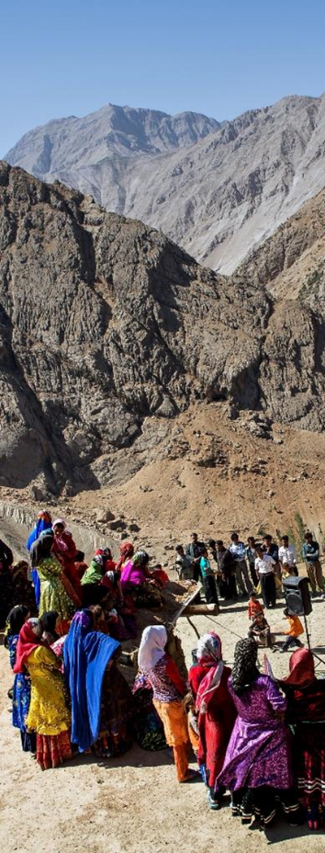
Overall context
Ideally mapping in Google Earth would be done as part of a broader participatory process
This should follow FPIC as much as possible
This can be achieved through communication about why, how and what will happen, including data storage and use, and commitments made by authors
Aims and methods can also be co-designed
This would ideally be a continuous process:
in advance of the research
in a community meeting at the beginning (and end) of the research period AND/or
clear communication at the beginning of each interview

Slide 4
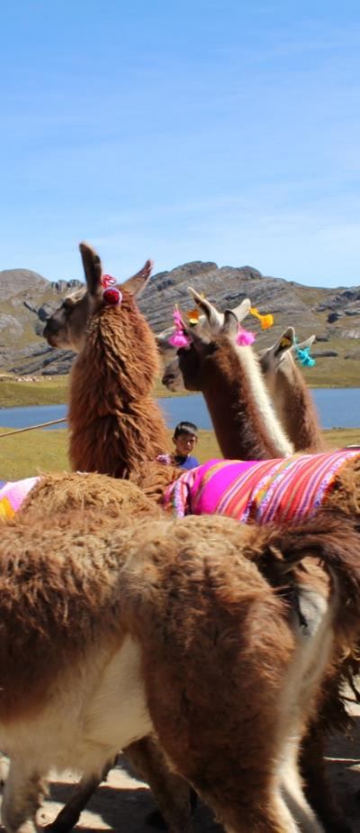
Mapping directly into Google Earth
Advantages:
Flexible
Relatively easy to set up
Results can immediately be saved, stored and shared
Results can be combined / disaggregated to create a range of maps and analyses
Results can be added to with new rounds of research
Maps and digital copies can be returned to communities
Disadvantages:
Participants can struggle to understand the map
It can work better with individual or small groups

Slide 5
Set up
The ideal setting for carrying out a direct-to-digital interview session includes the following:
A separate room with a door that can be closed to ensure background noise doesn’t get recorded and privacy for the interviewee
Darker setting with some lamps or backlights
A table to set up equipment
A clear white wall or screen to project map
However, mapping can be done in smaller spaces if needed

Slide 6
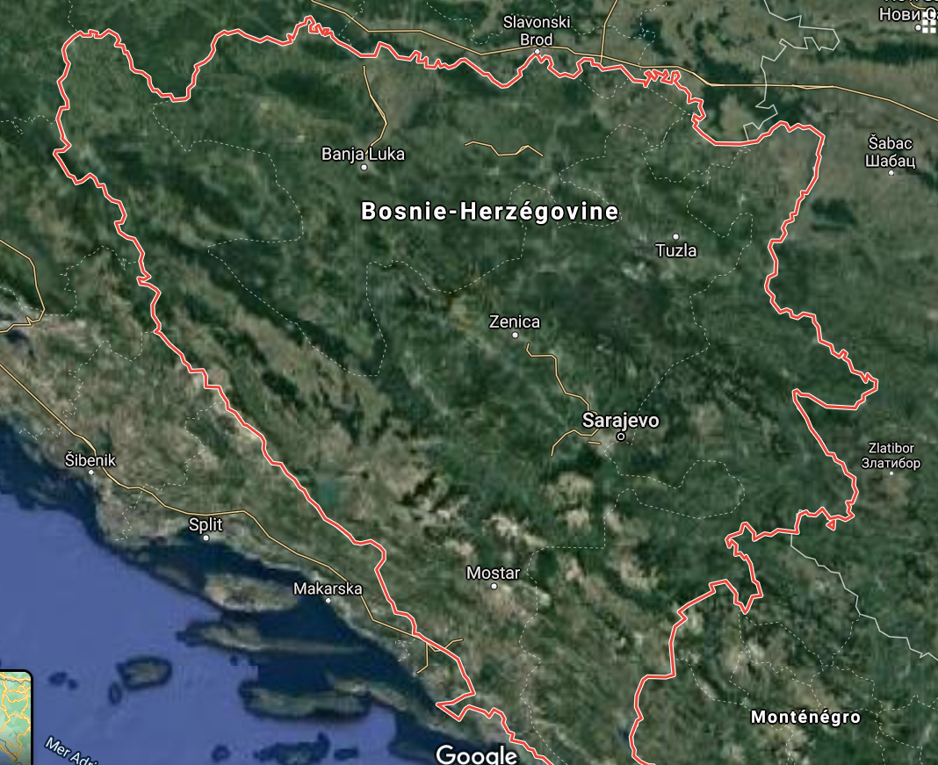
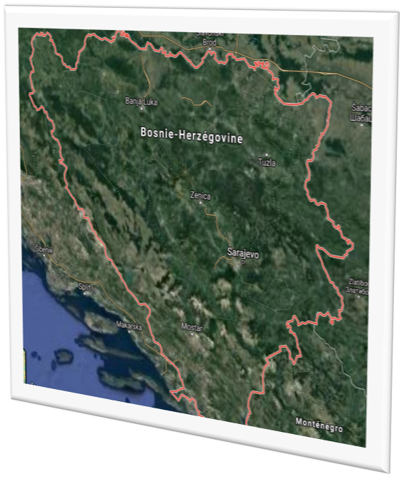
Set up
Additional equipment:
Laser pointer
Audio recorder
Video recorder
Participant
Mapper

Slide 7
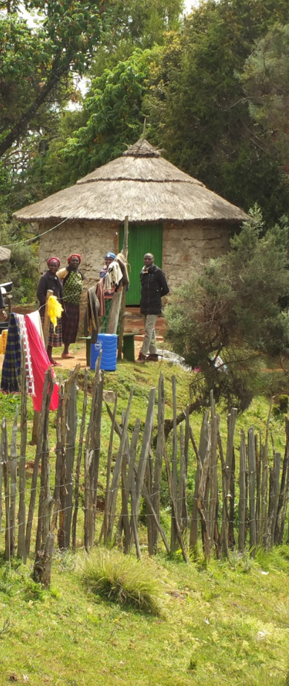
General guidance
Often a semi-structured interview style works best – develop an interview guide
In some interviews you may not map much at all
It can be good to start with questions about the participant’s life, as this will provide reference points later, e.g. when and where you were born, where have you lived (and when) etc
Take the time to introduce the participant to the map so they feel comfortable and orientated – letting them find their house can be a good start
If possible, make the mapping part of the interview – invite the participant to direct you so you are working together on building up the map

Slide 8
Codes
Participant code: advise either study or village names, and a number. E.g. the 4th participant in the NEA study could be N04, or the 17th participant from Visoko could be V17.
Activity or species codes.
Species: E.g. DE = Deer; WF = White fish
Habitat: MC = Moose calving; FS = Fish spawning
Activity: HU = hunting; MH = Moose hunting
Change: HD = habitat deterioration; LS = loss of species
Think about what you will want to analyse later
Be consistent, do not double up codes

Slide 9
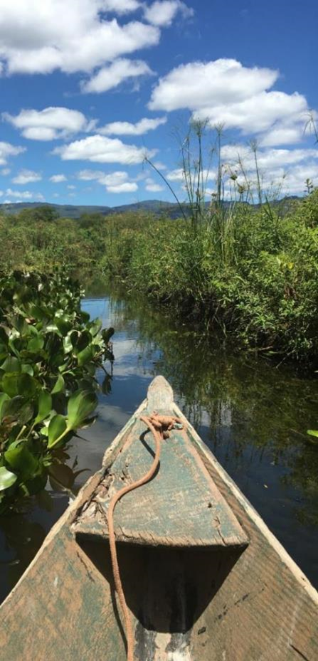
Next steps
Think about what you want to map (livelihood activities, species, habitat, change etc)
Develop an interview guide – can be a checklist
Devise codes for the mapping
Devise participant IDs – these could be based on their village, the study number etc
Practice…

Slide 10
FPIC
Guardianship – participants who represent organizations and communities
Principles of guardianship will be discussed with IPLC participants at the beginning of IPBES activities.
Participants who represent organizations or communities will act as the guardians of the use of the knowledge and materials from their respective organizations or communities that is shared before, during or after the workshop.
Any use of their organizations’ or communities’ knowledge will be discussed and approved by the guardians, as legitimate representatives of their organizations or communities.
Guardians are expected to contact their respective organizations and communities when they need advice.
Guardians are also expected to seek consent from their organizations or communities when they consider that this is required, keeping in mind that sharing details of their community’s knowledge can potentially have negative consequences, for example sharing the locations and uses of medicinal plants.

Slide 11
FPIC
FPIC rights during dialogue workshops and other activities
The FPIC rights of the indigenous peoples participating in dialogue workshops or other activities will be discussed prior to the beginning of the activity, until participants feel comfortable and well informed about their rights and the process, including the eventual planned use and distribution of information. This discussion may be revisited during the activity, and will be revisited at the end of dialogue workshops once participants have engaged in the dialogue process.
Participants do not have to answer any questions that they do not want to answer, and do not need to participate in any part of an activity in which they do not wish to participate;
At any point, any participant can decide that they do not want particular information to be documented or shared outside of the activity. Participants will inform organizers and other participants of this. Organizers and participants will ensure that the information is not recorded. Participants can also request that the information is only recorded as a general statement attributed to a region or country, rather than to a specific community.
Permission for photographs must be agreed prior to photos being taken and participants have the right not to be photographed. Organizers will take note of this.

Slide 12
FPIC
After the activity
Permission will be obtained before any photograph of a participant is used or distributed in any form.
Permission will be obtained before any list of participants is used or distributed in any form.
Participants maintain intellectual property rights over all information collected from them about themselves or their communities, including photographs. Their intellectual property rights should be protected, pursuant to applicable laws.
Copies of all information collected will be provided to the participants for approval.
Any materials developed for IPBES assessments or other products using information provided by participants will be shared with the participants for prior approval and consent.
The information collected during the activity will not be used for any purposes other than those for which consent has been granted, unless permission is sought and given by participants.
Participants can decline to consent or withdraw their knowledge or information from the process at any time, and records of that information will be deleted if requested by the participant. Participants should however be aware that once an assessment is published it cannot be changed, and information incorporated into the assessment cannot therefore be withdrawn from the assessment after this point.
Participants should have the opportunity of reviewing and commenting upon the final product, bearing in mind that responsibility for the final product rests exclusively with the authors.

Slide 13
Thank you!

