Slide 1
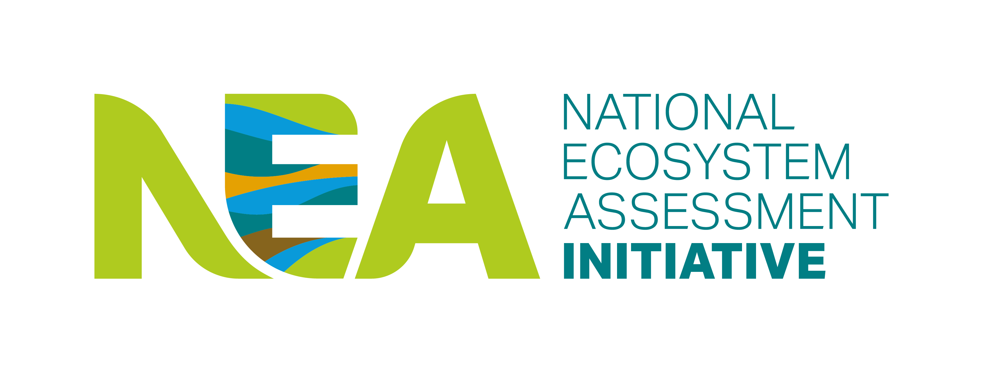






CELEBRATING GLOBAL ACHIEVEMENTS AND CONTRIBUTIONS
2022-2023

Slide 2
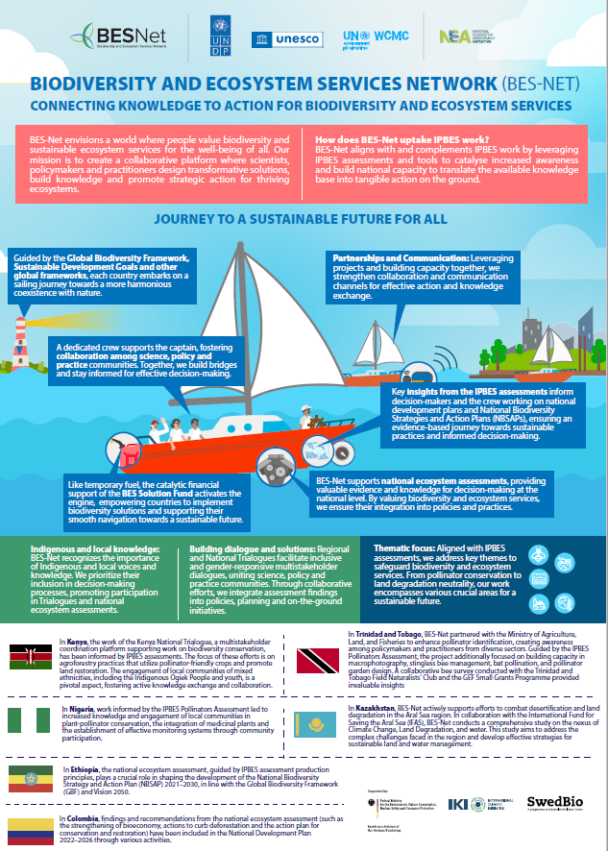
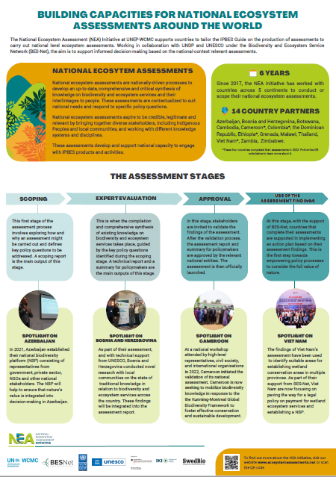
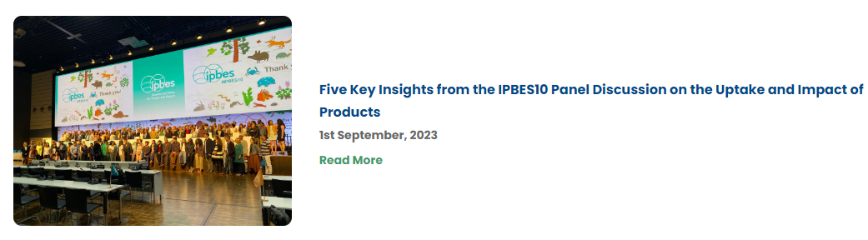
Contributions to Global Instruments: IPBES
IPBES 10:
Panel Discussion on the Uptake and Impact of IPBES Products: Malawi Insights
Exhibitions During IPBES 10
Opportunities
IPBES Nexus Assessment: A potential case study on human-rights based approach from Colombia NEA
Possibilities of NEA authors and completed assessments to directly contribute to IPBES assessments
Further investigating, in the NEAs, noted knowledge gaps in the IPBES assessments, i.e., invasive alien species
Considering uptake of relevant IPBES assessments in the use of NEA findings phase
Notes:
Peer-to-peer capacity building and knowledge exchange among country partners: This year, country partners got much more experience and knowledge on certain important areas of the assessment process, for example, the inclusion of Indigenous and Local Knowledge and the involvement of Indigenous Peoples and local communities in the assessment development. Between 2022 and 2023, experts of country teams were invited to participate in other country teams’ meetings, including inception and project launching workshops, to exchange their knowledge, and providing important guidance and support.
Public awareness: Relevant information about the development of national ecosystem assessments and the participatory and inclusive processes undertaken by our country partners was made available well beyond national borders, reaching the international community, for example within the IPBES community, where a presentation was held during the Stakeholder Day, prior to the 10th IPBES session, and posters regarding the use of the assessment findings in countries where assessments have been developed.

Slide 3
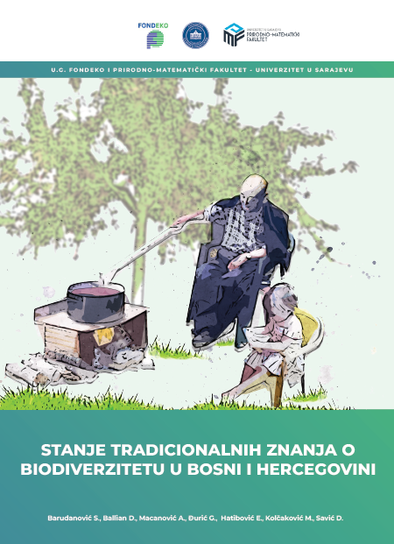
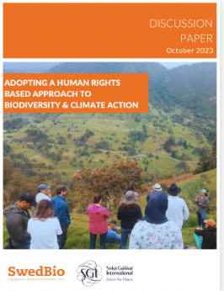
Contributions to Global Instruments: CBD
COP 15: December 2022
A session on "Science and traditional knowledge" during Restoration Day: Cambodia and Malawi contributions
Webinar Series: How NEAs can support the implementation of KM-GBF: Contributors: NEA Initiative, Colombia, Thailand and BES-Net
OEWG-12 on Article 8(j):
Bosnia and Herzegovina: Highlight of NEA ILK work and publication on status of traditional knowledge
SBSTTA 25:
Indirect Contribution: SwedBio paper on "Adopting human rights-based approach to biodiversity and climate action" capturing Malawi NEA ILK experience presented at SBSTTA 25
Opportunity: How can NEA process contribute to NBSAPs revision and implementation
Notes:
Peer-to-peer capacity building and knowledge exchange among country partners: This year, country partners got much more experience and knowledge on certain important areas of the assessment process, for example, the inclusion of Indigenous and Local Knowledge and the involvement of Indigenous Peoples and local communities in the assessment development. Between 2022 and 2023, experts of country teams were invited to participate in other country teams’ meetings, including inception and project launching workshops, to exchange their knowledge, and providing important guidance and support.
Public awareness: Relevant information about the development of national ecosystem assessments and the participatory and inclusive processes undertaken by our country partners was made available well beyond national borders, reaching the international community, for example within the IPBES community, where a presentation was held during the Stakeholder Day, prior to the 10th IPBES session, and posters regarding the use of the assessment findings in countries where assessments have been developed.

Slide 4

Peer-to-Peer Capacity Building and Knowledge Exchange
Global
Peer-to-peer session on NBP to support the implementation of CBD during IPBES 10: Exchange between BES-Net, NEA Initiative and CABES countries
NEA Global Workshop: NEA countries community and diverse expertise from consortium partners
Bilateral Exchanges
Colombia-Dominican Republic
Botswana-Malawi
Malawi-Thailand
Dominican Republic-Malawi
Opportunities
Strengthening private sector and IPLCs participation in NBP
Organizing continuous peer to peer exchange sessions
Notes:
Peer-to-peer capacity building and knowledge exchange among country partners: This year, country partners got much more experience and knowledge on certain important areas of the assessment process, for example, the inclusion of Indigenous and Local Knowledge and the involvement of Indigenous Peoples and local communities in the assessment development. Between 2022 and 2023, experts of country teams were invited to participate in other country teams’ meetings, including inception and project launching workshops, to exchange their knowledge, and providing important guidance and support.
Public awareness: Relevant information about the development of national ecosystem assessments and the participatory and inclusive processes undertaken by our country partners was made available well beyond national borders, reaching the international community, for example within the IPBES community, where a presentation was held during the Stakeholder Day, prior to the 10th IPBES session, and posters regarding the use of the assessment findings in countries where assessments have been developed.

Slide 5
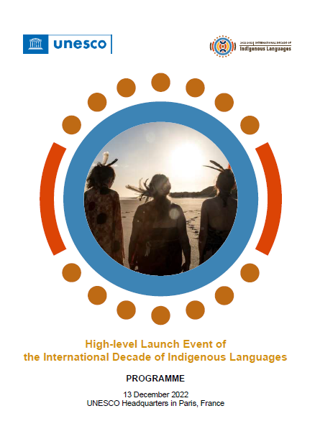
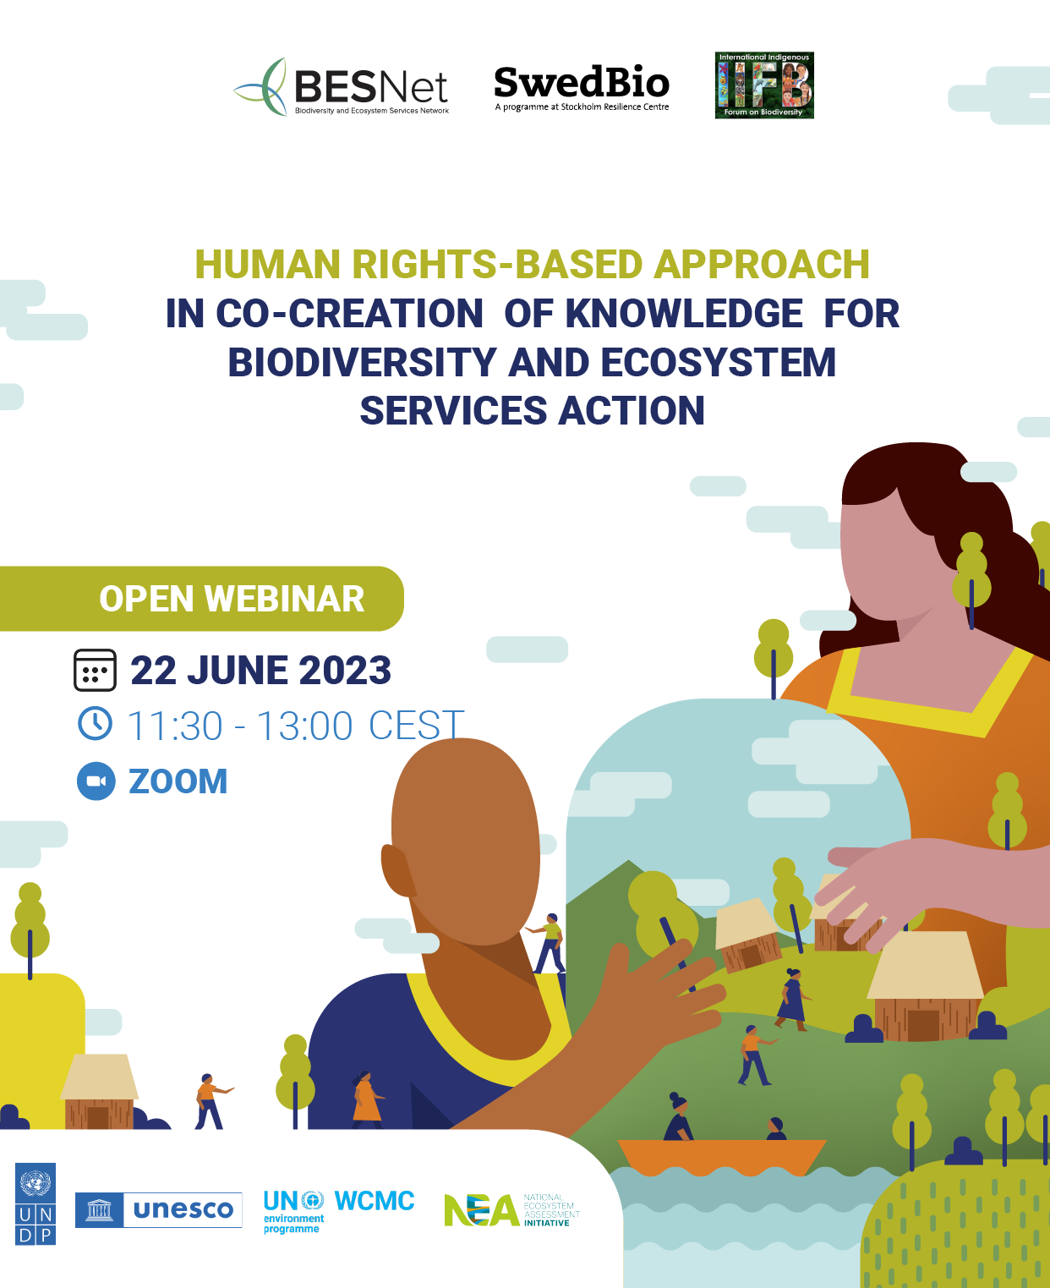
Global Knowledge Sharing
Celebration of LINKS 20th Anniversary and UNESCO launch of the International Decade of Indigenous Languages (Dec 2022): Contributions from BiH, the Dominican Republic, Malawi, Thailand and the NEA Initiative.
Webinar "Human Rights based Approach (HRBA) in Co-creation of Knowledge for Biodiversity and Ecosystem Services Action": BiH's experience on HRBA was anchored in the NEA process.
Opportunities
Exploring interlinkages between Indigenous knowledge and Indigenous languages in line with your country's action plan for the implementation of International Decade of Indigenous Languages (2022-2032)
Mainstreaming HRBA in the NEA process
Notes:
Peer-to-peer capacity building and knowledge exchange among country partners: This year, country partners got much more experience and knowledge on certain important areas of the assessment process, for example, the inclusion of Indigenous and Local Knowledge and the involvement of Indigenous Peoples and local communities in the assessment development. Between 2022 and 2023, experts of country teams were invited to participate in other country teams’ meetings, including inception and project launching workshops, to exchange their knowledge, and providing important guidance and support.
Public awareness: Relevant information about the development of national ecosystem assessments and the participatory and inclusive processes undertaken by our country partners was made available well beyond national borders, reaching the international community, for example within the IPBES community, where a presentation was held during the Stakeholder Day, prior to the 10th IPBES session, and posters regarding the use of the assessment findings in countries where assessments have been developed.

Slide 6
Expansion of BES-Net Advisory Commitee
International Indigenous Forum on Biodiversity and Ecosystem Services (IIFBES) - Open-ended and self-organizing network facilitating IPLCs participation in IPBES process
IPBES 10 "Exchange session with IIFBES": BiH and Malawi contributions
Outcome: IIFBES joined BES-Net Advisory Committee
Learn more in the upcoming November BES-Net Newsletter
Opportunity
IPLC organizations can join IIFBES. See here
Notes:
Peer-to-peer capacity building and knowledge exchange among country partners: This year, country partners got much more experience and knowledge on certain important areas of the assessment process, for example, the inclusion of Indigenous and Local Knowledge and the involvement of Indigenous Peoples and local communities in the assessment development. Between 2022 and 2023, experts of country teams were invited to participate in other country teams’ meetings, including inception and project launching workshops, to exchange their knowledge, and providing important guidance and support.
Public awareness: Relevant information about the development of national ecosystem assessments and the participatory and inclusive processes undertaken by our country partners was made available well beyond national borders, reaching the international community, for example within the IPBES community, where a presentation was held during the Stakeholder Day, prior to the 10th IPBES session, and posters regarding the use of the assessment findings in countries where assessments have been developed.

Slide 7

Thank you

