Slide 1
National to global: How do national ecosystem assessments fit within the global context?
National Ecosystem Assessment Initiative Global Workshop 2023
27 November 2023

Slide 2
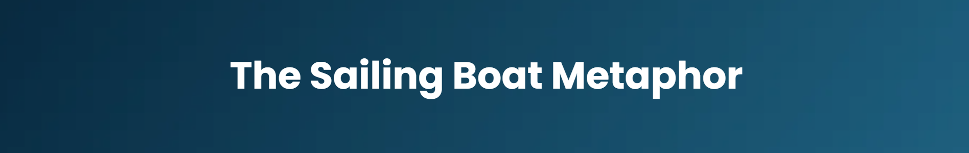
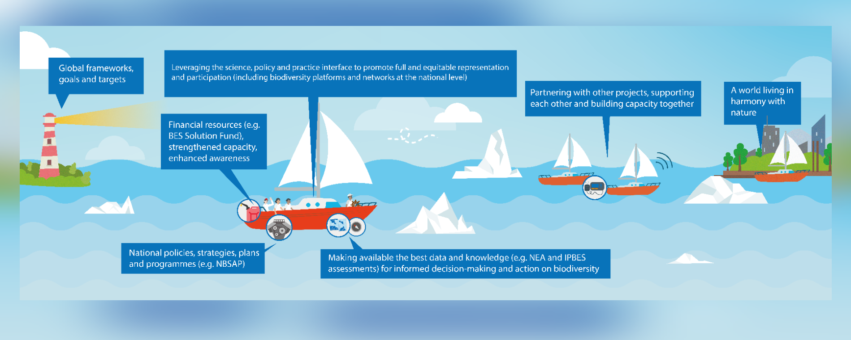

Slide 3
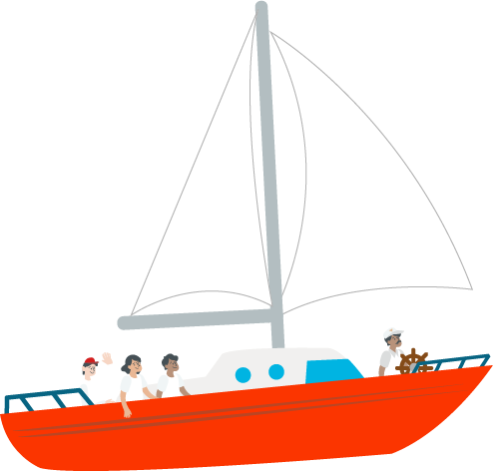








NEA as an integral part of the sailing expedition
Policy-science nexus building
Networking & partnership
Knowledge/evidence base
Informing policy
Transboundary coordination and communication
Engagement with global process

Slide 4


NEA in a nonstationary sailing boat
Evolving knowledge & new assessments
Tue
Thu
Sustainability of institutional mechanism
Wed
Fri
Mon
Changing policy priorities
From knowledge co-production to co-implementation
Thu
A broad range of knowledge & stakeholders
Maintenance of the community of practice
Thu
NEA
Emerging challenges & barriers
Resource requirements
Fri

Slide 5

Questions or comments for the presenter?

