Slide 1
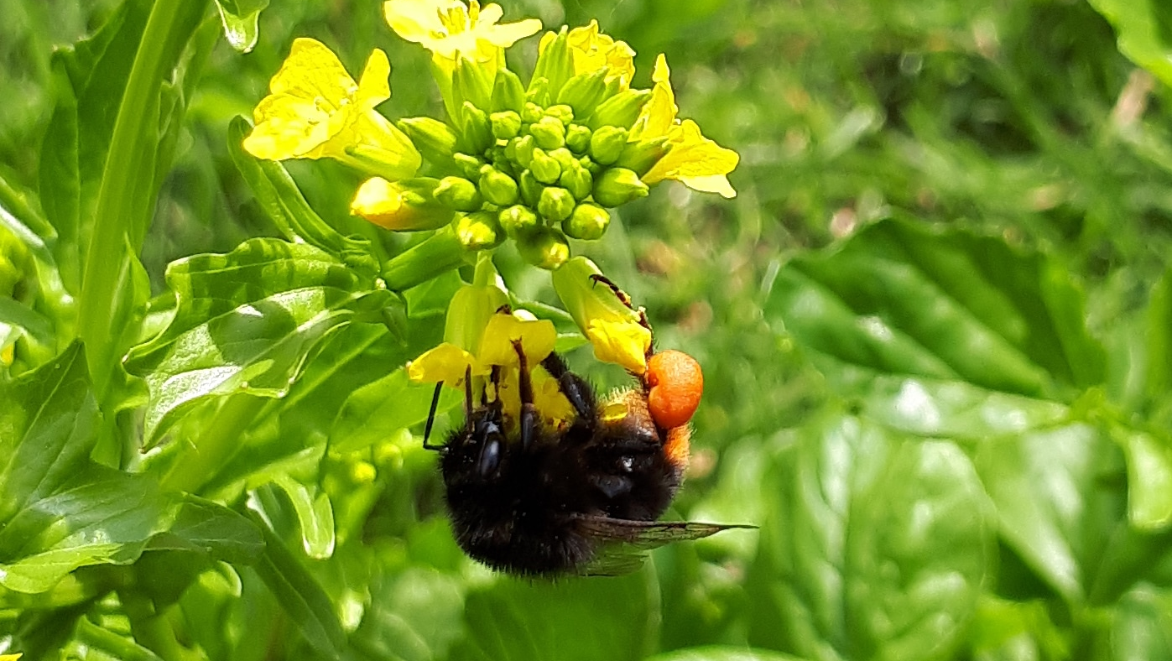
Pollinators in National Ecosystem Assessments
Tom Breeze, Simon Potts

Slide 2
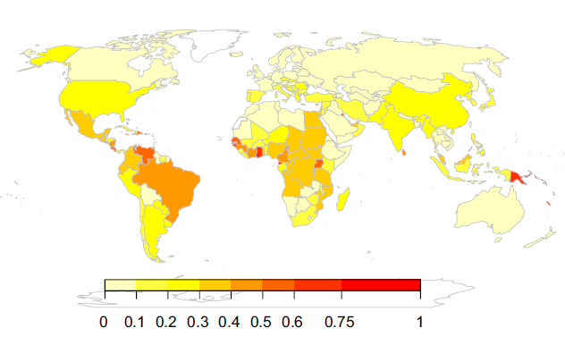
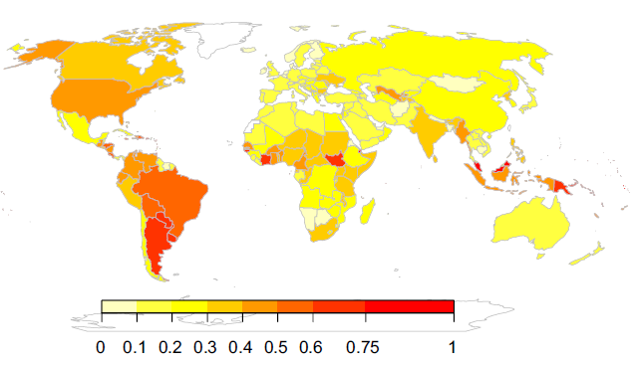
Overview of pollination
Pollination services to crops
  Globally: Pollinator dependence is growing,
  covering millions of Ha globally [1]
  In your countries: 3.97M ha (2019) [2]
  Major crops include Oil Palm, Soy and Cotton
  [3]
Pollination services to wild plants
  ~80% of global flowering plants depend
  on pollinators [4]
[1] Aizen et al., 2019. [2] FAOSTAT, 2022. [3] Klein et al., 2007, [4] Ollerton et al., 2011

Slide 3
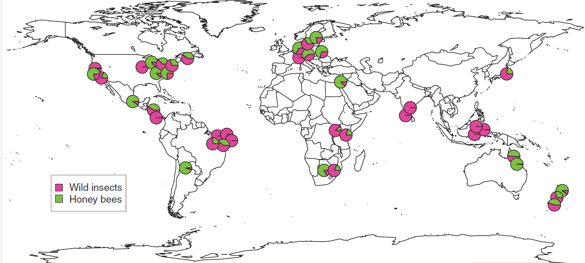
Status and Trends
In most countries, wild insects provide the majority of services
Other pollinators include bats and birds
[5] Garibaldi et al., 2013

Slide 4
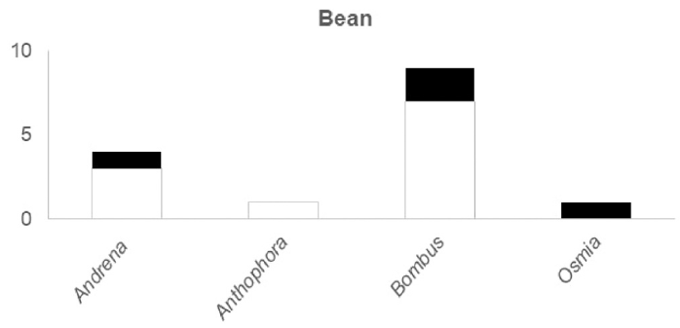
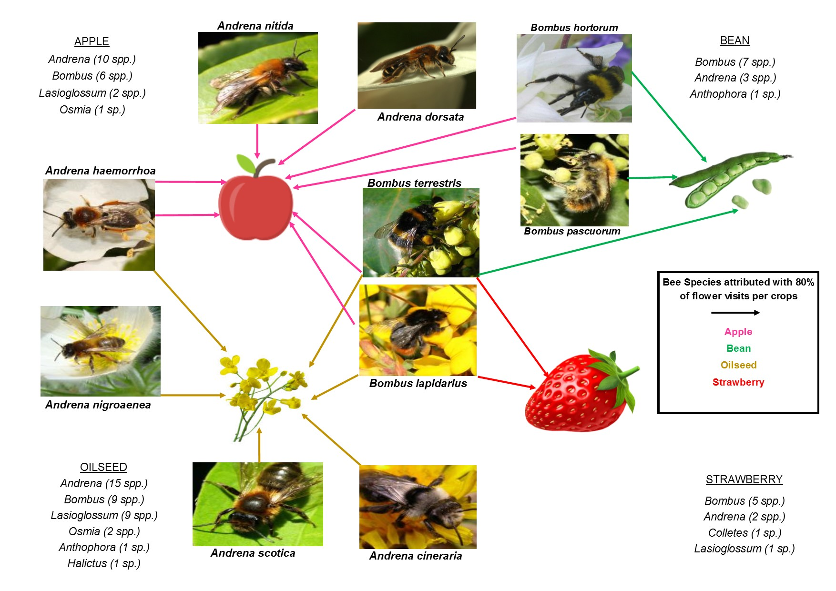
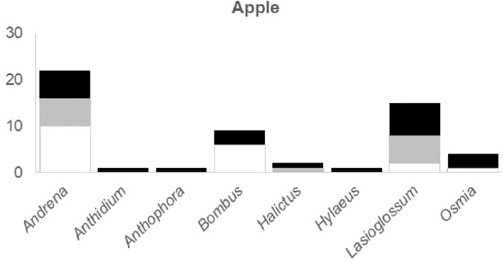
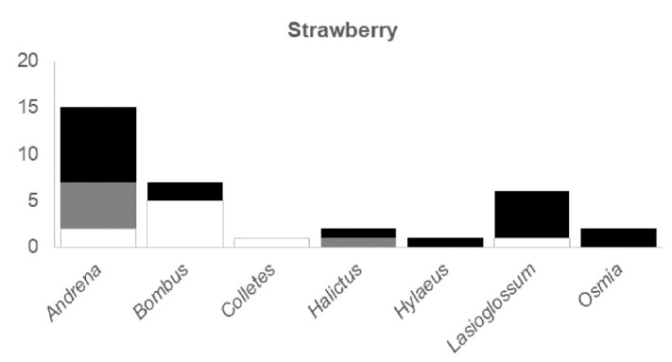
Status and Trends
Definite
Likely
Possible
[6] Hutchinson et al., 2021

Slide 5
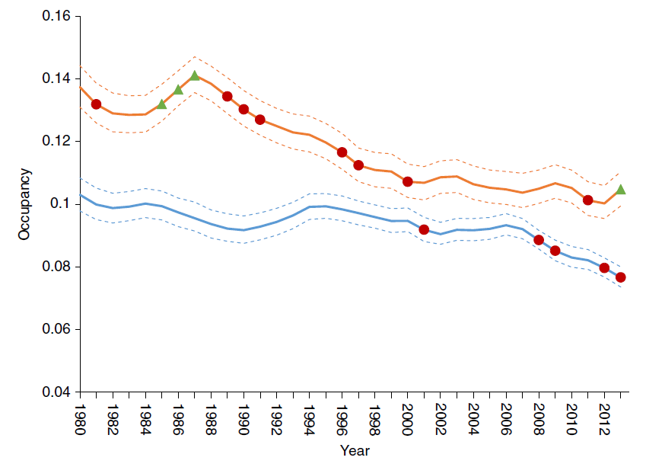
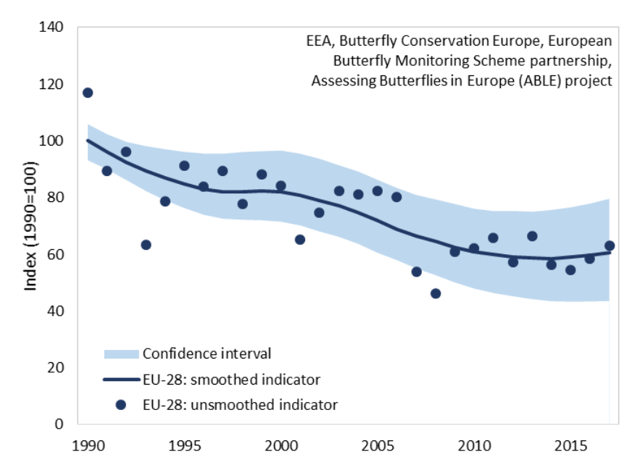
Status and Trends
Trends over time suggest declines
UK Bumblebees
UK Hoverflies
[7] Powney et al., 2021, [8] van Swaay et al., 2019
Notes:
If anyone wants a user friendly guide, refer to https://fukamilab.github.io/BIO202/09-C-occupancy-models.html also Outhwaite et al (2018)

Slide 6
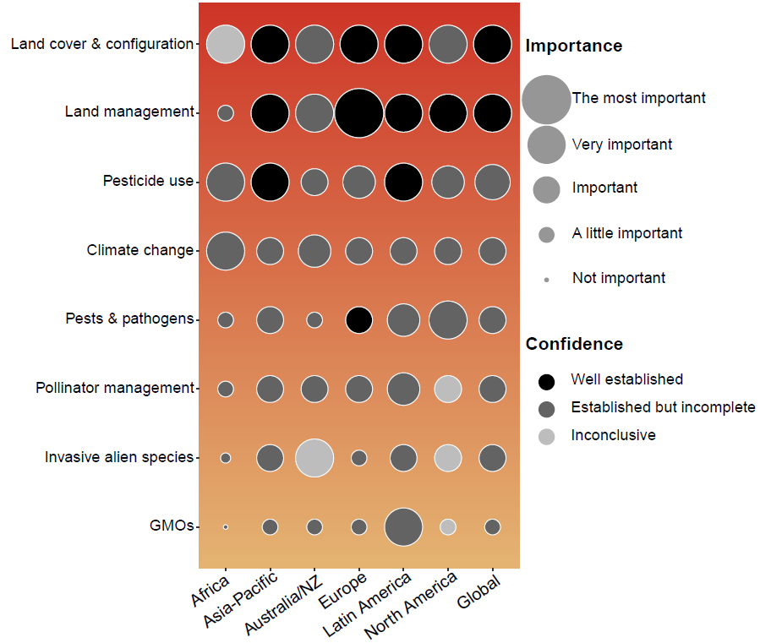
Drivers
Major drivers:
Land cover
Land management
Pesticides (not just insecticides)
Climate change
Much uncertainty still…
[9] Dicks et al., 2021
Notes:
If anyone wants a user friendly guide, refer to https://fukamilab.github.io/BIO202/09-C-occupancy-models.html also Outhwaite et al (2018)

Slide 7
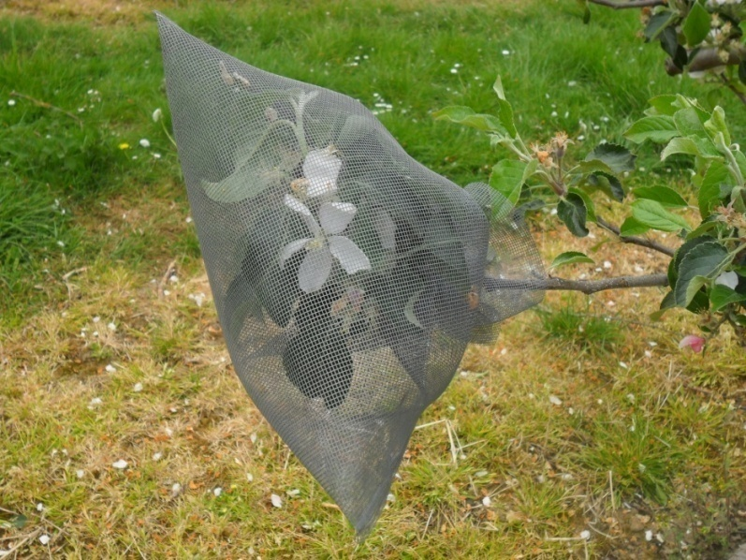
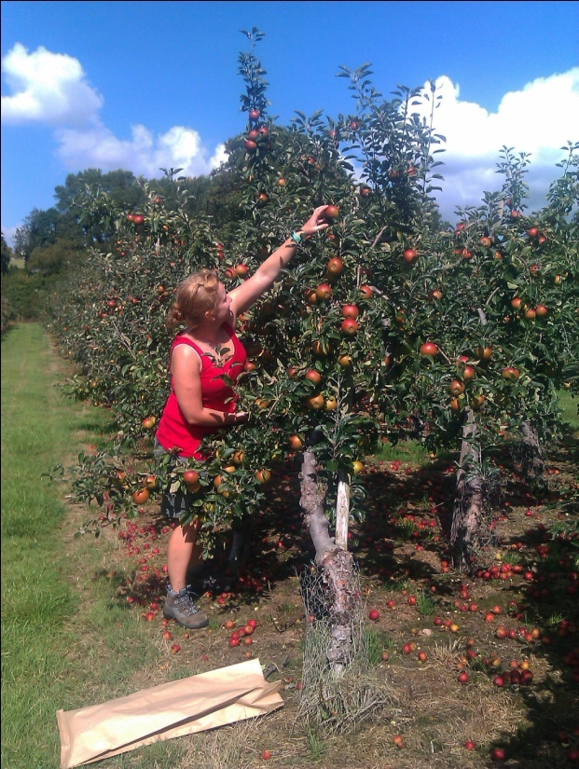
Pollination deficits
Cox
Gala
£2000/ha
[10] Garratt et al., 2014

Slide 8
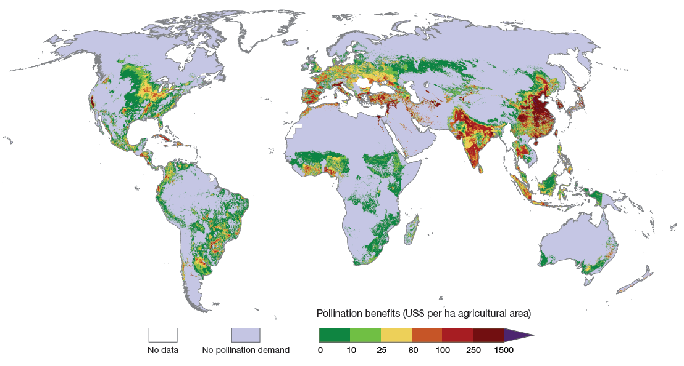
Global value: $235-577bn
[11] Lautenbach et al., 2012

Slide 9
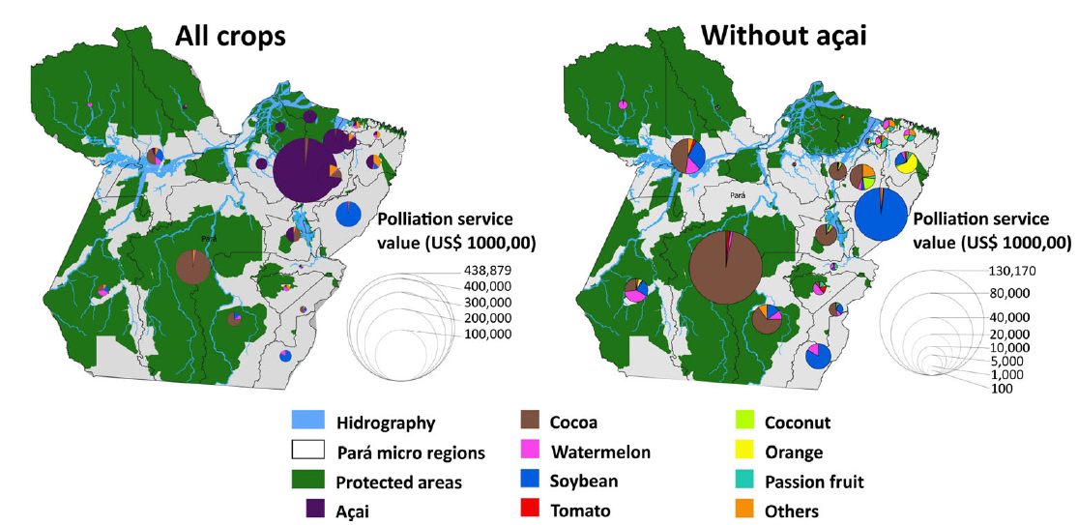
Value of pollination
Capturing the value of all crops is crucial [23]
[12] Borges et al., 2020

Slide 10
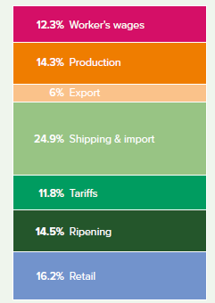
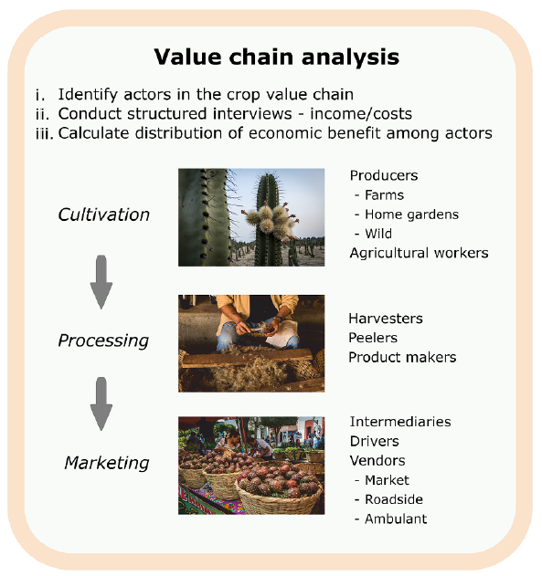
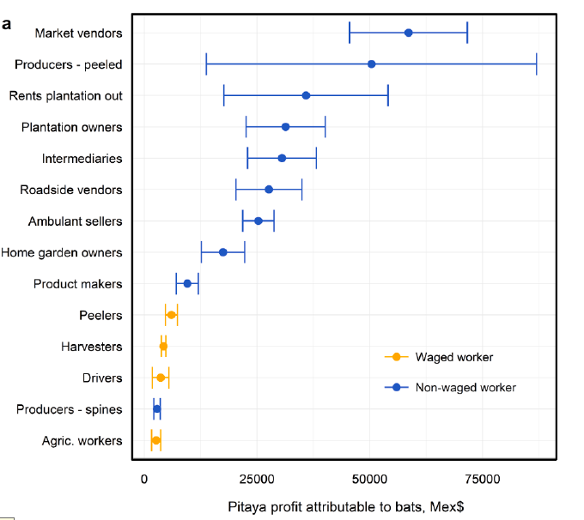
Value of pollination
The value of pollination can increase through the value chain & trade
[13] Hasnain et al, 2021. [14] Tremlett et al., 2021

Slide 11
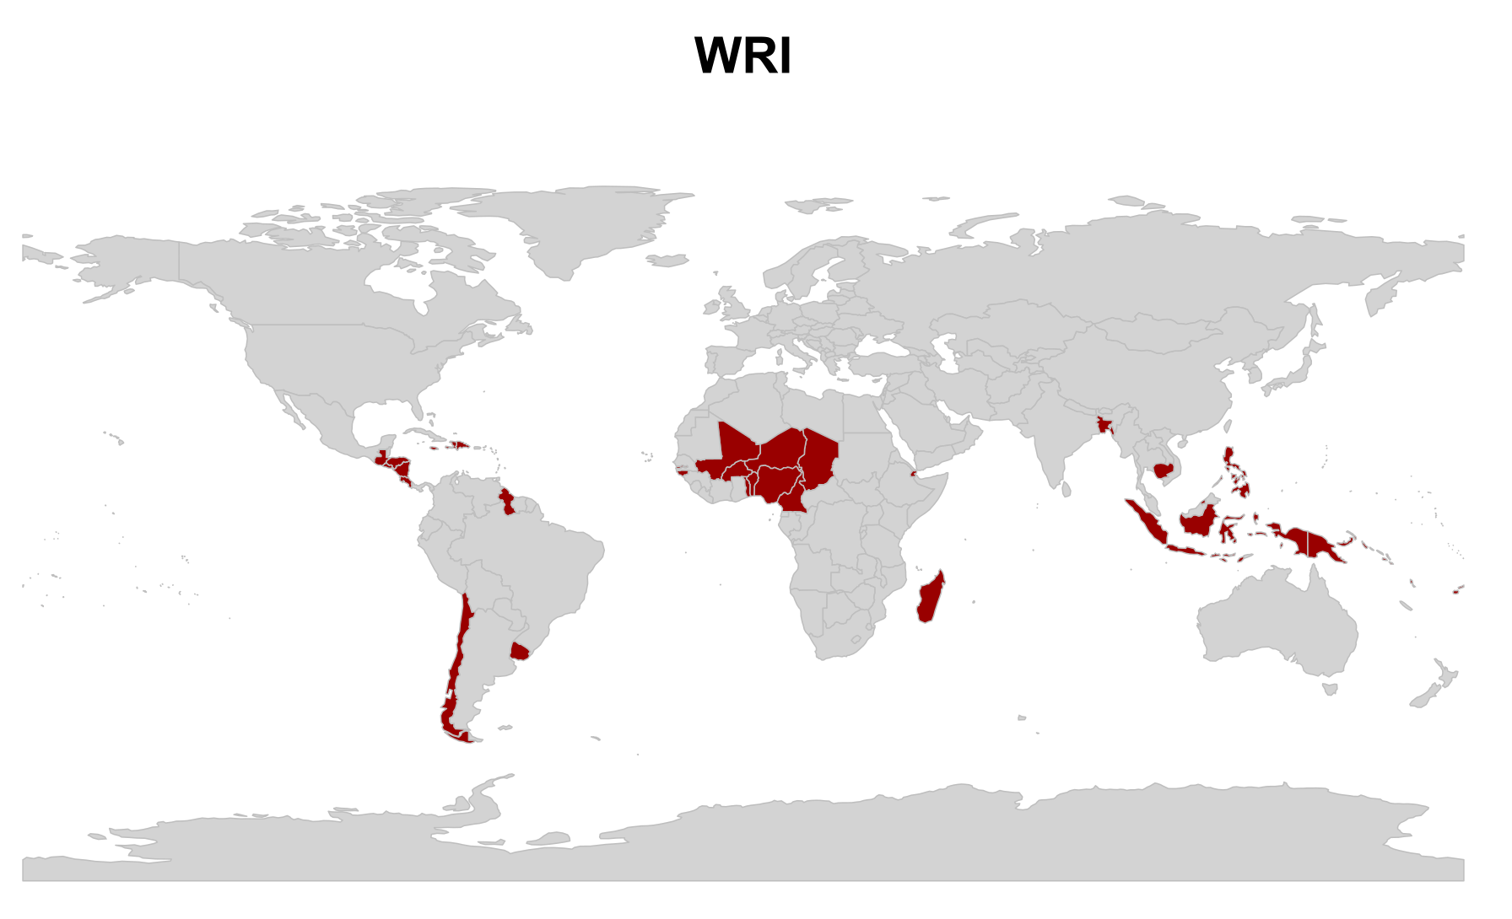
Disaster Risk
[15] Murphy et al., 2022
Countries where pollinators are lost

Slide 12
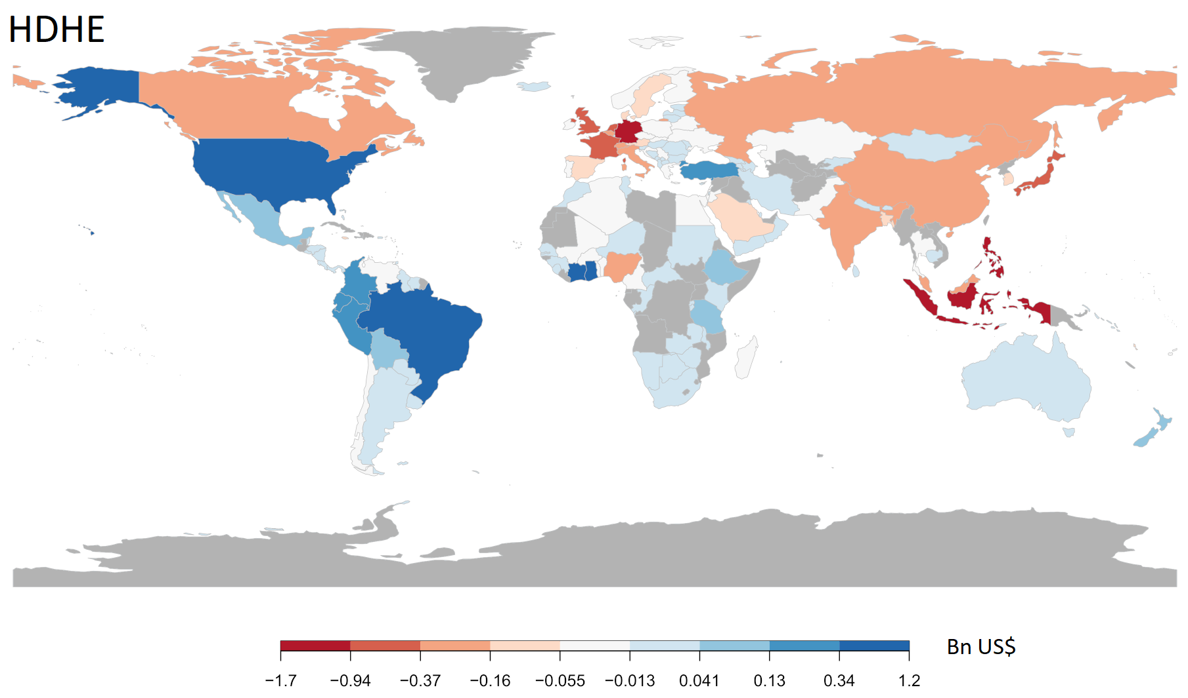
Disaster Risk
[15] Murphy et al., 2022

Slide 13
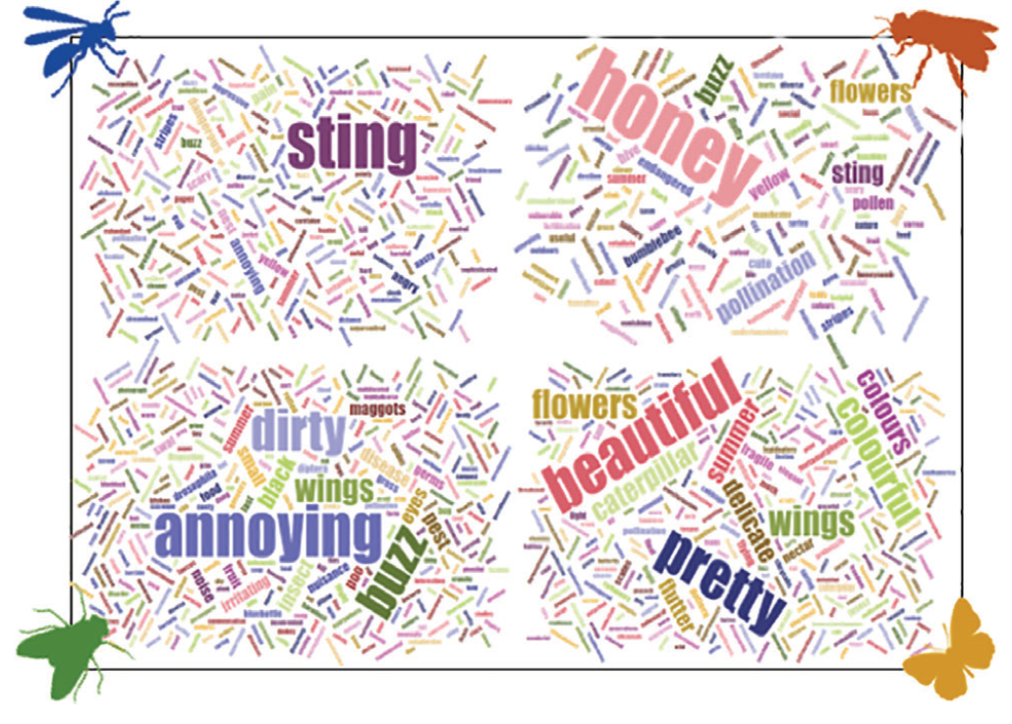
Value of pollination
Nutritional value
  Pollinators contribute to nutrition by improving
  the quantity and availability of nutrients [32]
Social values
  Pollinators contribute cultural value in themselves
  and through pollinating culturally valuable plants
[16] Chaplin-Kramer et al., 2014. [17] Sumner et al., 2018

Slide 14
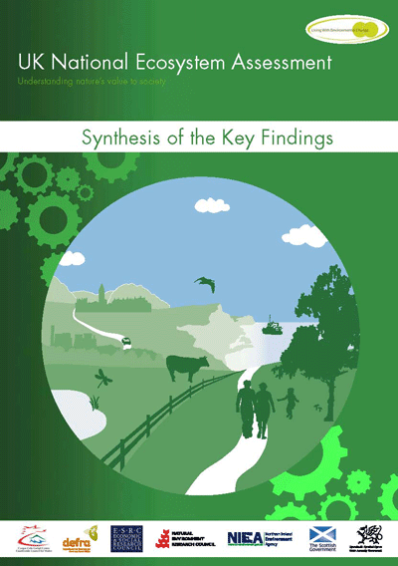
Why include pollinators in NEAs?
UKNEA (2011) [18]
Outlined the importance of pollinators to crops and ecosystems
Highlighted their status and trends
Gave evidence on their main pressures and mitigations

Slide 15
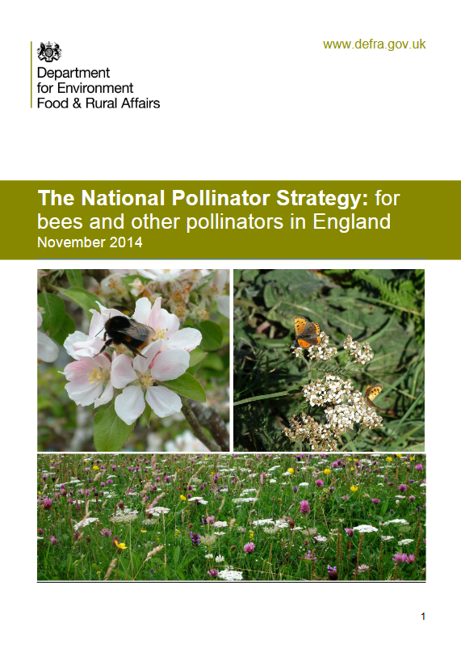

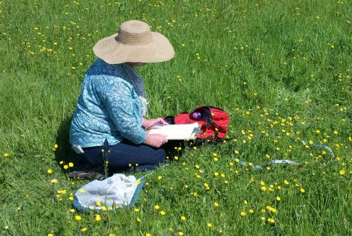
Why include pollinators in NEAs?
UK Pollinator Strategy (2014) [19]
UK Pollinator Monitoring Scheme [20]

Slide 16
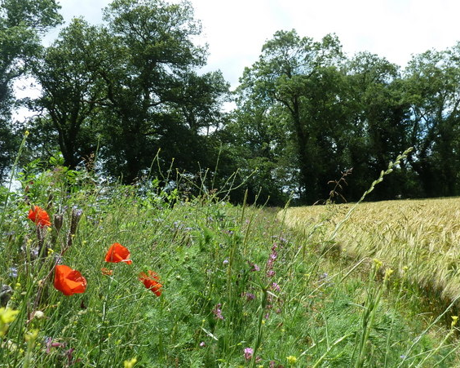
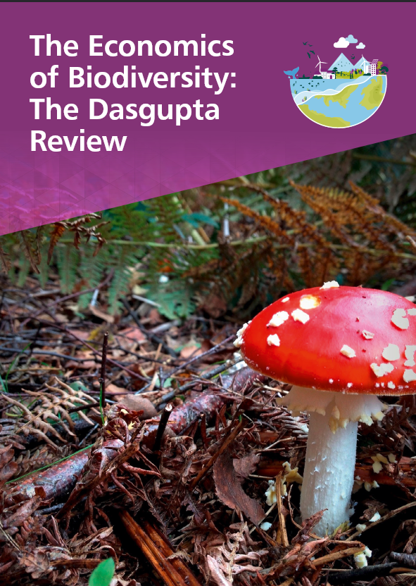
Why include pollinators in NEAs?
Countryside Stewardship (2015) [21]
Dasgupta Review (2020) [22]

Slide 17
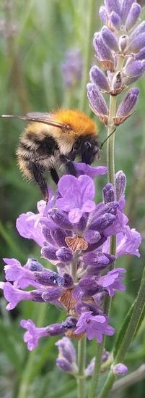
Important statistics for NEAs
Key Data
This is the most basic data that is useful in itself
How many animal pollinated crop species are there?
How many species of wild pollinators are there?
How many managed honeybees are there?

Slide 18
Important statistics for NEAs
How many animal pollinated crop species are there?
  FAO/National statistics
  Other local sources
How many species of wild pollinators are there?
  National museums
  Literature
How many managed honeybees are there?
  National beekeeping societies
  National agricultural statistics

Slide 19
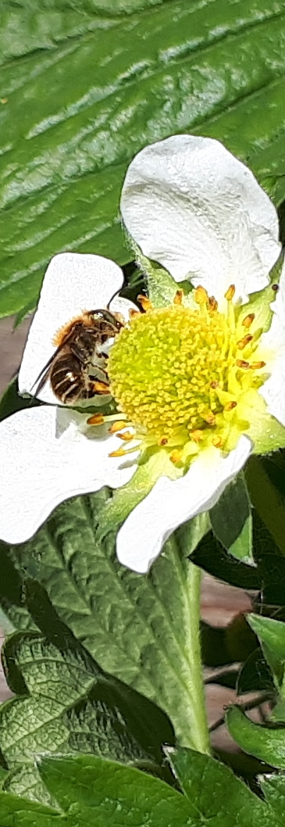
Important statistics for NEAs
Basic Data
This data is useful itself but can be easily transformed to create eye-catching statistics on the importance of pollination
What is the area of pollinated crops?
What is the total yield of pollinated crops?
How much do pollinated crops sell for?
How pollinator dependent are local crops?
What species are key pollinators?
What policy includes pollinators directly?

Slide 20
Important statistics for NEAs
Basic Data
What is the area/yield of pollinated crops and how much do they sell for?
  Gives an overview of how important pollinators are
  National and FAO statistics
  Local farmers markets
How pollinator dependent are local crops?
  Klein et al., (2007) [2] is a global review but needs an update
  Primary literature for specific crops
  *Field studies using bagging experiments
Can be transformed into economic values

Slide 21
Important statistics for NEAs
Basic Data
What species are key pollinators?
  Important to identify priority species
  Identified from literature
  Can be estimated from literature in other countries
  *Observational field studies
What policy includes pollinators directly?
  Useful for an overview of the current policy landscape
  Review of current policy documents on e.g. biodiversity
  *Consultation with relevant stakeholders

Slide 22
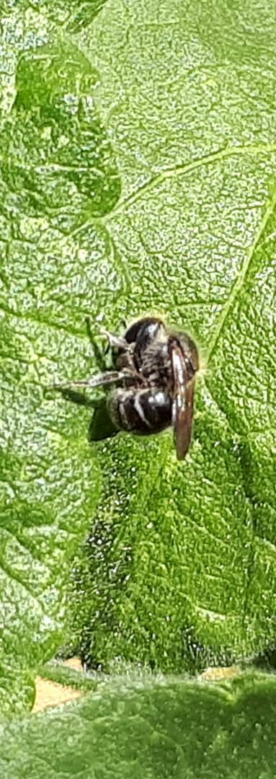
Important statistics for NEAs
Intermediate Data
This data is harder to acquire but can be transformed into management recommendations or analyses of values
Number of pollinated wild plant species
Information on key traits (e.g. emergence, size) of pollinators
Spatially explicit maps of habitats at a coarse (>1Km) resolution
Pollinated crop prices (paid by other actors)
Honeybee hive rental costs
Beekeeper payments to farmers
Information on the consumption of crops in local diets

Slide 23
Important statistics for NEAs
Intermediate Data
Number of pollinated wild plant species
  Gives an indication of the importance of pollination to wider ecosystems
  Drawn from the literature
  Botanical databases (e.g. Kew [23]) may help
Information on key traits (e.g. emergence, size) of pollinators
  Allows linking of pollinators to plants & analysis of trends
  Drawn from literature
  *Traits can be estimated from specimens in the field or museums

Slide 24
Important statistics for NEAs
Intermediate Data
Spatially explicit maps of habitats at a coarse (>1Km) resolution
  Allows understanding of the general status of pollinator habitat
  Land records
  Local or satellite mapping data
Pollinated crop prices (paid by other actors)
  Illustrates the importance of pollinated crops to other actors
  Government databases on crop trade
  *Direct interviews with stakeholders (e.g. retailers, co-operatives)

Slide 25
Important statistics for NEAs
Intermediate Data
Honeybee hive rental costs/beekeeper payments to farmers
  Important to understand the managed pollinator market
  Some beekeeping societies keep records
  *Surveys of beekeepers and farmers
Information on the consumption of crops in local diets
  Allows us to illustrate how important pollinators are to health
  Government databases on food consumption
  *Food diaries and surveys

Slide 26
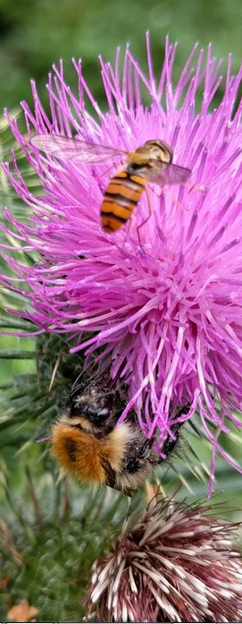
Important statistics for NEAs
Advanced Data
This data will need dedicated work to gather and/or model but will result in some of the most powerful evidence.
Managed pollinators
Wild honeybee population estimates
Map of managed honeybee distribution
Numbers of other managed pollinators used in agriculture

Slide 27
Important statistics for NEAs
Advanced Data
This data will need dedicated work to gather and/or model but will result in some of the most powerful evidence.
Trends and pressures
Information on species occurrence
Systematic transects data of pollinators
Spatially explicit climate data
Spatially explicit maps of habitats at a high (<1km) res.
Spatially explicit data on pesticide use

Slide 28
Important statistics for NEAs
Advanced Data
This data will need dedicated work to gather and/or model but will result in some of the most powerful evidence.
Values
Observational data of key plant-pollinator networks
Information on pollinated crop value chains
Crop price elasticities of demand
Cross-price elasticities of crops
Information on social and cultural values of pollinators

Slide 29
Important statistics for NEAs
Advanced Data
Managed pollinators
Illustrates the importance of managed pollinators and the pressures they may pose to wild species.
Trends and pressures
Allows us to map and model pollinator populations and track their populations over time relative to ecosystems/crops
Values
Allows us to highlight the values to wider society, including international trade

Slide 30
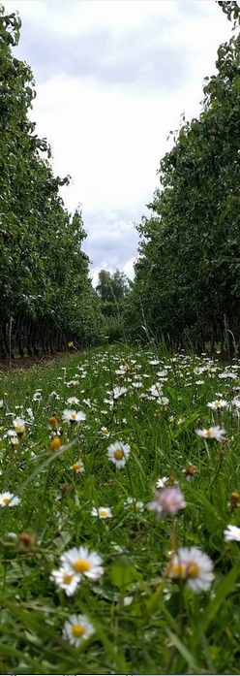
Discussion session
What do you think pollinators will fit in your assessment?
What information do you think would be most useful?
What data is actually available?
What can we do to support you?

