Slide 1
Foresight Scenarios
Session 1: An Introduction

Slide 2
Session 1: An Overview
Purpose
A short introduction
What are scenarios
Why use them
We may not be able to know the future – but we can imagine it.

Slide 3
Purpose
To provide you with an introduction to what scenarios are about
Understand some of the terminology
What they can and cannot do
Why you should consider using Foresight Scenarios

Slide 4
First some history

Slide 5
A short history - 1
There is general agreement that the practice of using foresight scenarios started seriously at the RAND Corporation in the 1950’s – building on advances in military planning developed during World War II.
The RAND Corporation was set up to research new forms of weapons technology. RAND’s Hermann Kahn used the technique – adopting the term scenarios from the cinema (instead of the less serious ‘screen play’) – to produce detailed analyses written as if it written by people living in the future; communicating about the future through stories told in the future. It was used, for example, to analyse the relationship between weapons development and military strategy.
Around the same time Stanford University set up the Stanford Research Institute (SRI), to offer long-range thinking for business incorporating operations research, economics and political strategy alongside hard science and military consulting.

Slide 6
A short history - 2
In the 1960’s there was a shift in emphasis as interest grew in how to plan for changes in society - in the USA this was spurred by upheavals resulting from the Vietnam War.
  One example was the Office of Education, which was interested in what changes should be made to the education system considering possible societal changes – 5 scenarios were developed only one of which followed the ‘official’ line.
  SRI also did work for the Environmental Protection Agency, creating 10 to 12 scenarios of the future.
At around the same time companies like Shell, Corning, IBM and General Motors were introduced to future scenario thinking.
In the 1970’s there was the work of the Club of Rome model looking at interconnections between population, food production, industrial production, pollution, and natural resources, published later as the “Limits to Growth”

Slide 7
A short history - 3
Scenarios have been used to guide government policy and plans. In 1991-1992, the Republic of South Africa (RSA) engaged a team from Shell to help them envision the future of RSA post-apartheid. Four scenarios were developed and then reverse engineered the decisions required along the way to achieve the future state most preferred by all stakeholders.
From 2000 onwards there has been a proliferation of foresight studies. The UK Government uses future tools and techniques to support policy making – it has produced 32 Foresight Reports since 2003
Other examples include:
The Millennium Ecosystems Assessment which draws on global scenarios
The Representative Concentration Pathways (RCP) adopted by the Inter-Governmental Panel on Climate Change (IPCC)
The International Panel on Biodiversity and Ecosystem Services’ (IPBES) Regional Assessment Reports on biodiversity and ecosystem services https://ipbes.net/assessment-reports/asia-pacific

Slide 8
Takeaway messages
The use of foresight scenarios:
Is not new
Has been applied to a wide range of challenges and to different sectors

Slide 9
The future is uncertain
Coping with uncertainty is a major challenge so how do we make decisions about the future in the face of the complex interaction of social, economic, environmental and political changes?
The complexity suggests that there linear and non-linear connections and interdependencies, a change in any one of which can lead to very different outcomes.
Where do scenarios fit in?

Slide 10
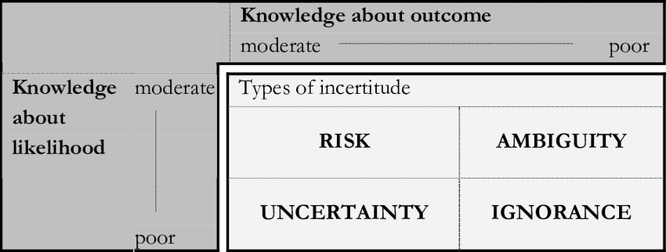
What is the situation we are in?

Slide 11
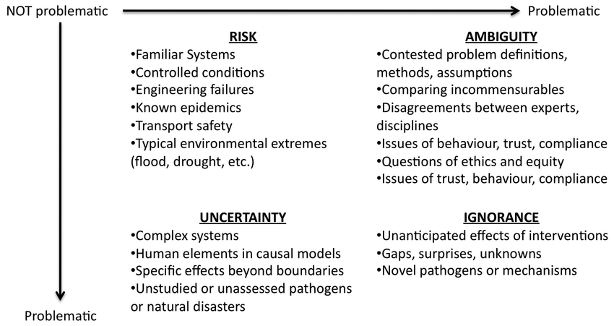
Examples of the different situations

Slide 12
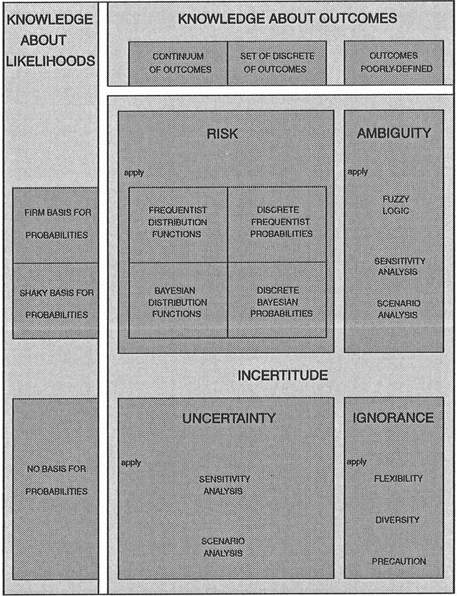
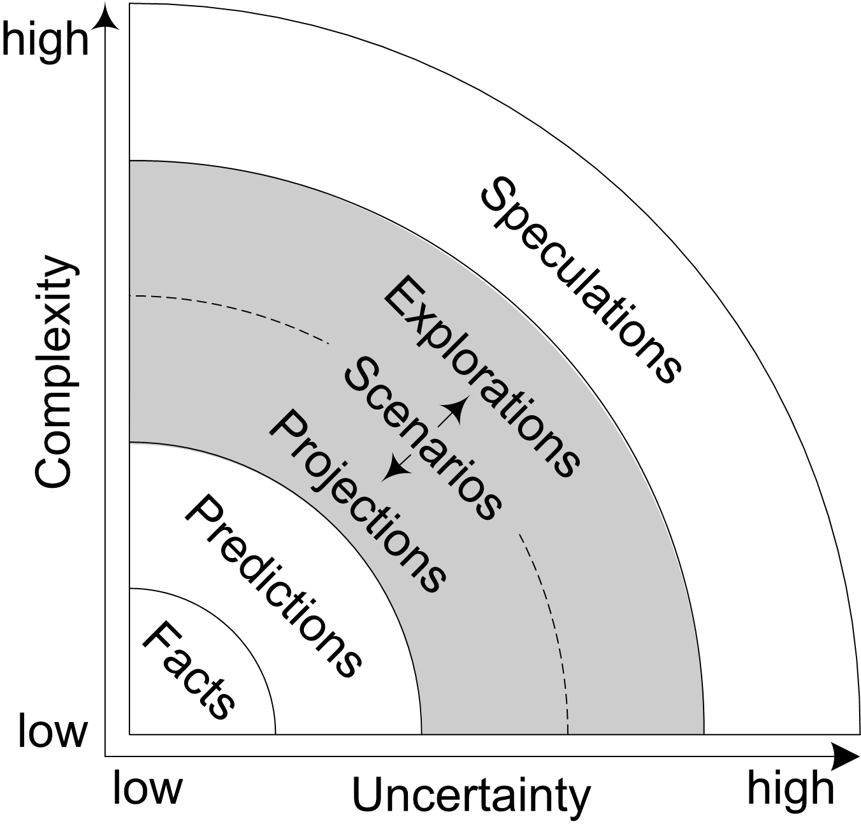
How do we cope with the situation?

Slide 13
What are scenarios?
First
There are issue with understanding the names and words used
The issues arise because of different disciplinary backgrounds
Understand what the words mean in the context that we are using them

Slide 14
What are scenarios
Terms used:
Foresight – is a structured and systematic way of generating ideas about the future to anticipate and better prepare for change. It is about exploring different plausible futures, and the opportunities and challenges they could present. The objective is not to ‘get the future right’, but to expand and reframe the range of plausible developments. A longer-term tool incorporating uncertainty.
Scenarios – are manifestations/descriptions of plausible future states which differ from each other in fundamental ways in responding to a set of drivers.
Scenario planning - explores the uncertainty inherent in looking at the long-term future through scenarios. Allows the exploration of alternative responses to the key guiding question.
Forecasting/Projections – assumes that the future looks much like it does today, does not anticipate significant shifts, uses quantitative inputs and methodology to predict what will, or should, happen by interpreting historical data. A shorter-term tool based on known variables in the system.

Slide 15
Forecasts vs. Scenarios
 | Forecasting | Scenarios
Purpose | Prediction of the future based on past historical information and trends Planning for one future | Thinking process to consider potential futures based on risks and uncertainties Planning for multiple futures
Certainty | Probable | Plausible
Information type | Quantitative | Qualitative & Quantitative
Risks & Uncertainty | Does not factor in risks and uncertainties, focuses on certainties | Considers risks and uncertainties
Testing | Can be tested for accuracy. | Difficult to test
Theoretical Basis | Based on theoretical models and statistics Future can be predicted | Based on relationships and causality Future is unpredictable
Stakeholder Engagement | Narrow, stakeholders involved in the process | Wide set of stakeholders involved in the process
Objectivity | Objective – fact based | Subjective – assumptions
Horizon | Short term perspective | Long term perspective
Repeatability | Results can be replicated | Unique representations

Slide 16
A quick overview of foresight
https://www.youtube.com/watch?v=OytuOln6X6Y

Slide 17
The future is uncertain
Coping with uncertainty is a major challenge so how do we make decisions about the future in the face of the complex interaction of social, economic, environmental and political changes?
The complexity suggests that there linear and non-linear connections and interdependencies, a change in any one of which can lead to very different outcomes.

Slide 18
Dealing with Uncertainty
Foresight Scenario thinking:
  Provides a structured process of thinking about and anticipating the unknown future, without claiming to predict the future or even influence the environment in a major way.
  Helps explore how the world might change and what the implications might be
The approach is to think and plan for future developments instead of waiting for them to happen

Slide 19
Aims of Foresight Scenario thinking include
:
Exploring the interrelationships between multiple factors in terms of cause/effect and chronology and to realize the possibilities are not endless
Understanding that whilst the future is largely unpredictable and unknown, it is also knowable and understandable to a certain degree
Provide a framework for better informed decision-making
Analysing the relationships between the critical uncertainties, important trends and the behavior of actors who have a stake in the particular future
Foresight Scenario thinking starts by asking questions about the future and what if questions:

Slide 20
Reasons why would you adopt a Foresight Scenarios approach
Scenarios provide a useful means to understand the dynamics underpinning different potential trajectories of future development. By incorporating future uncertainty this can help decision makers design policies and actions addressing the impacts of global and local.
It’s a systematic and purposeful processes of future-oriented deliberation with a view to identifying actions to be taken today for a better future tomorrow.
Provides a space for deliberation and strategic conversations between actors to create a pool of knowledge and analyses to inform debates and to provide a resource for others (decision-makers) to use.
Foresight time horizons are usually beyond the normal planning horizon but can vary depending on the issue. Time horizon can be up to 50 years or more in some cases.

Slide 21
Strengths of Foresight Scenarios
Foresight scenarios:
Respect differences and encourage multiple perspectives;
Combine quantitative and qualitative knowledge;
Combine different fields of knowledge and ways of knowing;
Reframe questions across disciplines;
Project the future as “full of possibilities”; and
Are based on collaborative conversations

Slide 22
Why might we use Foresight Scenarios as part of a National Ecosystems Assessment?
We should understand the reason why we are undertaking the Foresight scenario work

Slide 23
Discussion
What are some of the major uncertainties facing Cambodia and its Ecosystems?

Slide 24
What does Foresight Scenario development entail?
Taking the Long View
Thinking about how ‘The System’ works
Thinking broadly
Using what you have

Slide 25
Things we need to consider
Evaluation of scenarios or generation of scenarios?
Geographic scale
Time scale
Focus
Domain - economic, social, environmental, technological
Who wants scenarios, for what and for whom?
  Audiences and Users
How are we going to do the work – who should be involved
  Expert-led
  Stakeholder-led
  Mix of expert and stakeholder involvement

Slide 26
Influences
In thinking about Foresight Scenarios, we need to distinguish between:
Predictable variability and trends - normal variability around an average e.g. wet & dry seasons
Unpredictable random events - can be anticipated and prepared for though timing is not known e.g. volcanic eruptions, droughts
Uncertain long-term phenomena, their dynamics not fully understood e.g. technological change, climate change, global/regional economic development

Slide 27
When to use Foresight Scenario approaches
There are six typical questions that you can ask to help identify whether scenario approaches or forecasting will be more effective:
Is the future uncertain and unpredictable, or certain and predictable?
Are one or multiple futures more likely?
Is the focus on qualitative or quantitative analysis?
Are we looking for an objective, fact-based discussion with stakeholders or a subjective, wider-ranging discussion?
Are we looking for a shorter-term or longer-term perspective on the future?
Can the analysis results be replicated on an ongoing basis, or are they a one-time representation of unique information?

Slide 28
Characteristics of a good scenario and limitations of its use
Good scenarios:
Are based on analysis of change drivers
Enable critical uncertainties and predetermined elements to be distinguished
Are credible and compelling
Are internally logical and consistent.
Scenarios will not:
Make the decisions
Begin an unstoppable course of action
Ever be entirely right (although elements of each scenario could be)
Persuade everybody.

Slide 29
Types of Scenarios

Slide 30
So what types of future are there?

Slide 31
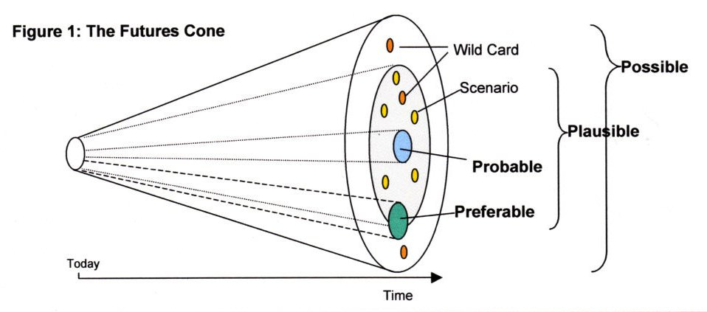
A taxonomy of potential alternative futures
It can be useful to consider four classes of potential alternative futures:
Possible
Plausible
Probable
Preferable
(Source: adapted from Hancock & Bezold 1994).
(Adapted from J. Voros, 2001)
https://thevoroscope.com/publications/foresight-primer/

Slide 32
Possible futures
Includes all the kinds of futures we can possibly imagine – those which ‘might happen’ – no matter how far-fetched, unlikely or ‘way out’. They might, as a result, involve knowledge which we do not yet possess (the ‘warp drive’ of Star Trek is a good example), or might also involve transgressions of currently-accepted physical laws or principles.
Can be characterised as being reliant on the existence of some future knowledge that we do not yet possess, for it to come about.

Slide 33
Plausible futures
Futures which ‘could’ happen according to our current knowledge of how things work.
Based on our current understanding of physical laws, processes, causation, systems of human interaction, etc. They are a smaller subset of futures than the Possible.

Slide 34
Probable futures
Futures which are considered ‘likely to happen’, and stem in part from the continuance of current trends.
Some probable futures are considered more likely than others; the one considered most likely is often called ‘business-as-usual’. It is a simple linear extension of the present.
However, trends are not necessarily continuous over long periods of time, and discontinuities in the trends may occur. Some trends may fade out suddenly, while new ones may emerge unexpectedly.
Just using trends gives rise to a much smaller class of futures than the previous two

Slide 35
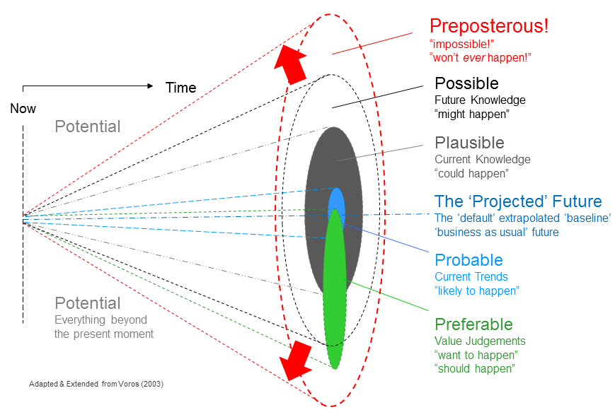
Preferred futures
Preferred futures are concerned with what we ‘want to’ happen; in other words, these futures are largely emotional rather than cognitive.
Based on value judgements and are more subjective than the previous three classes.
Because values differ so markedly between people, this class of futures is quite varied.
Preferable (or preferred) futures can be in any of the previous three classes

Slide 36
Approaches to Scenario Building
The choice of the type of approach depends on the PURPOSE as well as the scope and scale of analysis.
There are two main approaches used to identify relevant drivers and to construct the scenarios:
  Expert-based
  Participatory-based
Based on the scenario assumptions, different types of tools may be used to quantify the drivers and their impacts

Slide 37
Expert-based Approaches
All scenario construction implicitly involves some degree of expert opinion
Formal expert-based scenario development entails identifying and eliciting information from multiple experts, either individually or in a group
Expert-based approaches are particularly valuable for translating a perceptual model (i.e. qualitative understanding) into a formal model (i.e. mathematical representation)
Limitations include:
  Subjective choices and value laden assumptions related to disciplinary backgrounds
  Susceptible to scientific uncertainties
Experts can also be stakeholders

Slide 38
Participatory approaches
Participatory approaches to scenario development consist of involving a larger group of stakeholders through workshops or other formal meetings to share ideas and ultimately develop scenarios based on their collective knowledge
Benefits from mobilising local and indigenous expertise, as well as enabling participation and better informing local stakeholders
Challenges include the limited understanding of relevant issues – in particular the influence of external factors and inter-scale interactions
Difficulty in translating qualitative data into quantitative inputs

Slide 39
Types of scenario
Scenarios may be thought of as fitting into one of four types, depending on how they are to be used in decision-making:
Exploratory scenarios
Target seeking (back-casting)
Ex Ante scenarios (policy screening scenarios)
Ex Post scenarios (retrospective policy assessment)
Scenario construction is a valuable endeavour when attempting to construct possible futures in the context of uncertainties, particularly when ecological outcomes are highly contingent on indirect drivers such as economic growth and demography.

Slide 41
Comparing scenario types

Slide 42
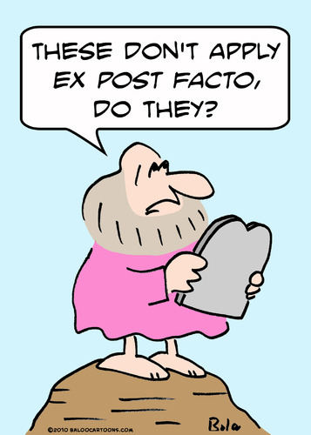
Ex Post scenarios
Ex-post assessments are the present evaluations of past efforts to achieve policy goals throughout all stages of the policy cycle and decision-making context
Ex-post assessments can be based on the straightforward monitoring of variables of interest as well as on a comparison of the achieved change or status with the original targets and the anticipated impacts of the implemented measures

Slide 43
Ex Ante scenarios
Ex-ante assessment is a proactive approach, oriented to identify and address potential effects of environmental policies
Ex-ante assessments use policy-screening scenarios to forecast the effects of alternative policy or management options (interventions) on environmental outcomes
Ex-ante assessment usually starts in the very early stages of a policy formulation and design
May contribute to the social acceptance of policies by anticipating and addressing conflicting objectives and adverse effects
Assessment may include expert considerations and consultations with relevant stakeholders
Similar to EIAs and SEAs

Slide 44
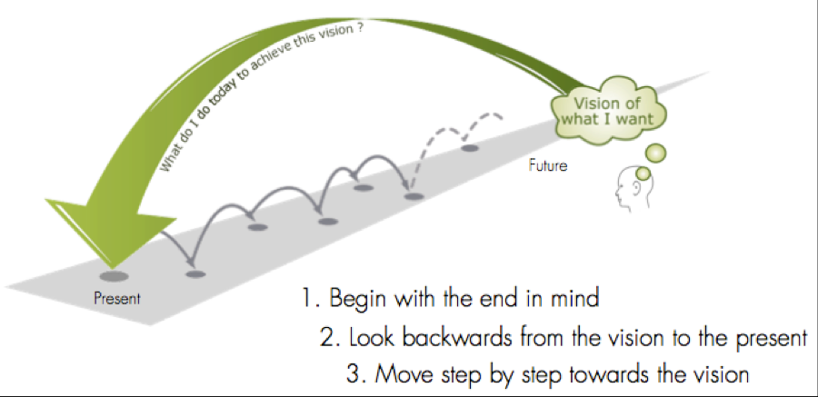
Target seeking scenarios
There is an agreed end point and the definition of a clear set of objectives that can either be specified in terms of achievable targets (e.g. in terms of the extent of natural habitats remaining, or of food production self-sufficiency) or as an objective function to be optimised (e.g. minimal biodiversity loss)
Target-seeking scenarios can also be though of as ‘normative scenarios’
Analyses, such as back-casting approaches, allows for the identification of multiple potential pathways to a desired future vision
Target-seeking scenarios are a valuable tool for examining the viability and effectiveness of alternative pathways to a desired outcome
This types of scenario helps to develop targets and indicators for the future and assists with the design of policies

Slide 45

Exploratory scenarios
Raises awareness of future policy challenges to inform agenda setting
Applicable where specific policy responses are being considered and/or the nature of the problem to be addressed is unclear
Can have strong qualitative and quantitative components and are often combined with participatory approaches involving local and regional stakeholders
Frequently employ a co-evolutionary approach through the use of matrices where the projection of divergent futures is based on changes in the indirect and direct driver assumptions
Flexibility to construct storylines (conducive to greater creativity), coverage over a wide range of outcomes
Applied to problem areas where specific policy responses have yet to be formulated or the nature of the problem remains unclear, hence relevant in the agenda-setting stage of the policy cycle
Utilised for climate change projections and were used in IPCC assessments

Slide 46
Normative (target seeking) versus Exploratory
For a fuller exploration watch this video
https://www.youtube.com/watch?v=YLm0pM2xxtk

Slide 47
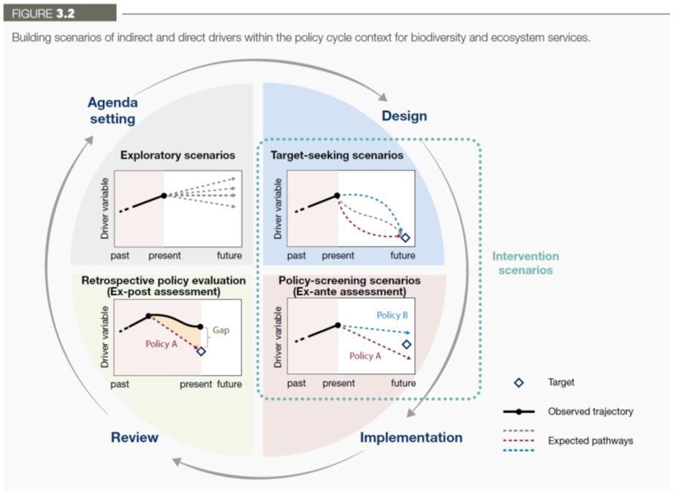
So just to recall

Slide 48
Example

Slide 50
Watch this video – The World in 2050
How do you feel about this?
What do you think the point of it is?
In what way is this useful?
https://www.youtube.com/watch?v=RNVh_HMX2IY

Slide 51
Open discussion, questions and comments

Slide 52
Recap
We have:
Looked at the history and development of Scenarios and their uses
Considered the difference between projections/forecasts and scenarios
Thought about why we might consider a scenario approach and what it could bring
Looked at some examples

Slide 53
That’s all folks

