Slide 1



Slide 2
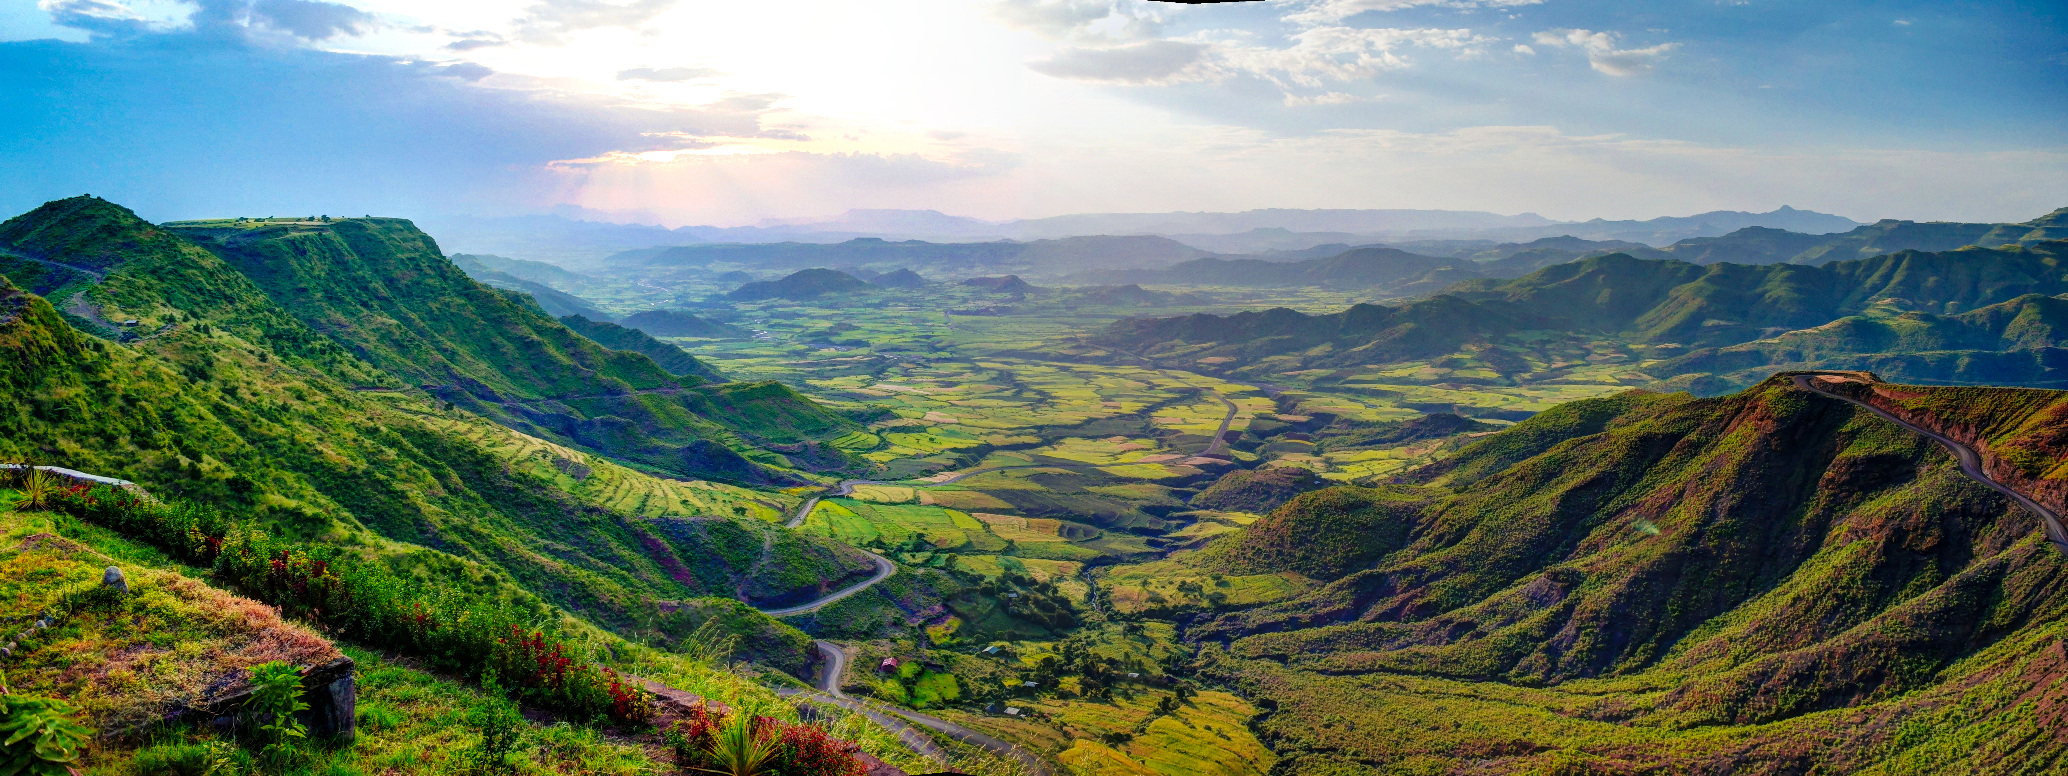


Webinar: Global presentation of Ethiopia’s National Ecosystem Assessment
- National ecosystem assessment initiative -
Semien mountains and valley around Lalibela, Ethiopia – by homocosmicos on AdobeStock

Slide 3




Housekeeping
Recording: This webinar will be recorded and will be uploaded to our NEA Initiative website. If you have any issues with this, please let us know.
Questions: If you would like to comment or ask a question during the Q&A session, please type it in the chat function accessible from the bottom of your screen.
Support: If you have any technical issues, please send a direct message to [Technical Support] Mel Wheeler via the chat.
Notes:
Before I proceed, I will just briefly cover housekeeping for today’s session…..

Slide 4
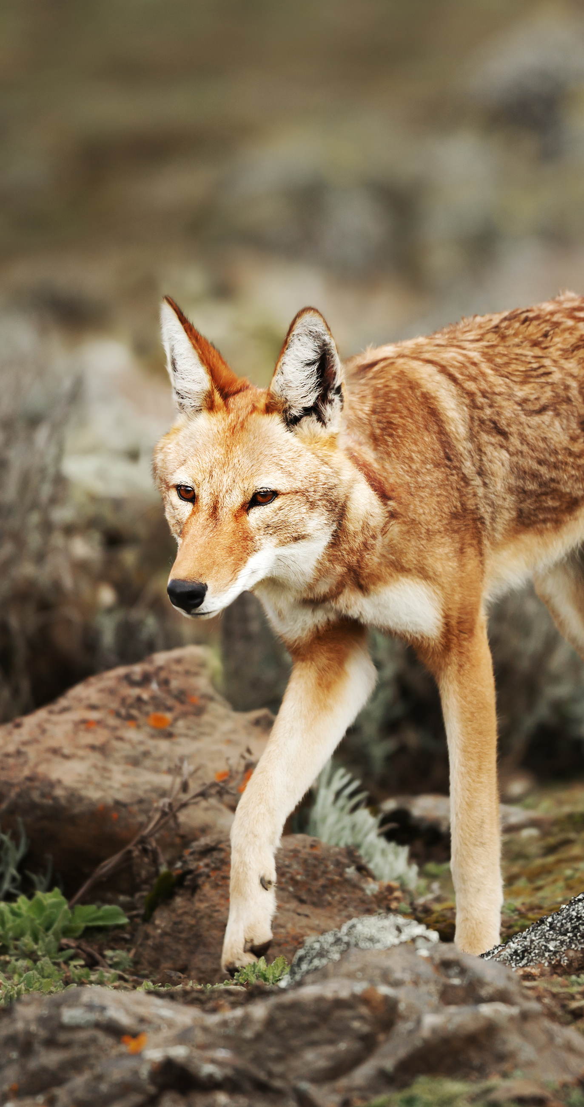

Webinar Agenda
Opening Remarks
Overview of Ethiopia’s National Ecosystem Assessment Process
Main Findings of Ethiopia’s National Ecosystem Assessment
Q&A Session
Challenges, Lessons, and Impacts from Ethiopia’s National Ecosystem Assessment
Q&A Session
Ethiopian Wolf – by giedriius on AdobeStock

Slide 5
In August 2021, UNEP-WCMC reconvened members and welcome new partners with the intention of strengthening the activities of the network. Since then we have delivered successfully the following open webinars:
The Sub-Global Assessment Network
Tailoring the IPBES methodology for national ecosystem assessments
Opportunities for impact from national ecosystem assessments
National ecosystem assessments to support implementation of the Convention on Biological Diversity
A community of practice that connects and supports individuals and organisations involved in sub-global ecosystem assessments
Global presentation of Vietnam’s National Ecosystem Assessment
Notes:
It is my pleasure to announce the reconvening of The Sub-Global Assessment Network (SGAN)
READ SCREEN
The SGAN aims to convene a community of practice building capacity and sharing experiences about sub-global ecosystems assessments. Members of the network may include practitioners, researchers and decision-makers.
By bringing together the National Ecosystem Assessment Initiative and the Sub-Global Assessment Network, UNEP aims to increase our support to countries undertaking sub-global ecosystem assessments and foster knowledge sharing and capacity building among those involved on assessments.
(In 2007, the United Nations Environment Programme (UNEP), in collaboration with a consortium of partners, convened the SGAN to provide ongoing support to sub-global assessments catalysed during the Millennium Ecosystem Assessment or in its follow-up.)

Slide 6
30/05/2022
Webinar 4. Global presentation of Ethiopia’s National Ecosystem Assessment
The Sub-Global Assessment Network
08/06/2022
Webinar 5. Brazilian national platform and assessments experience
06/2022
Webinar 6. Launch of the National Biodiversity Platform Guidebook by UFZ
Join the network and stay up to date with upcoming events

Slide 7
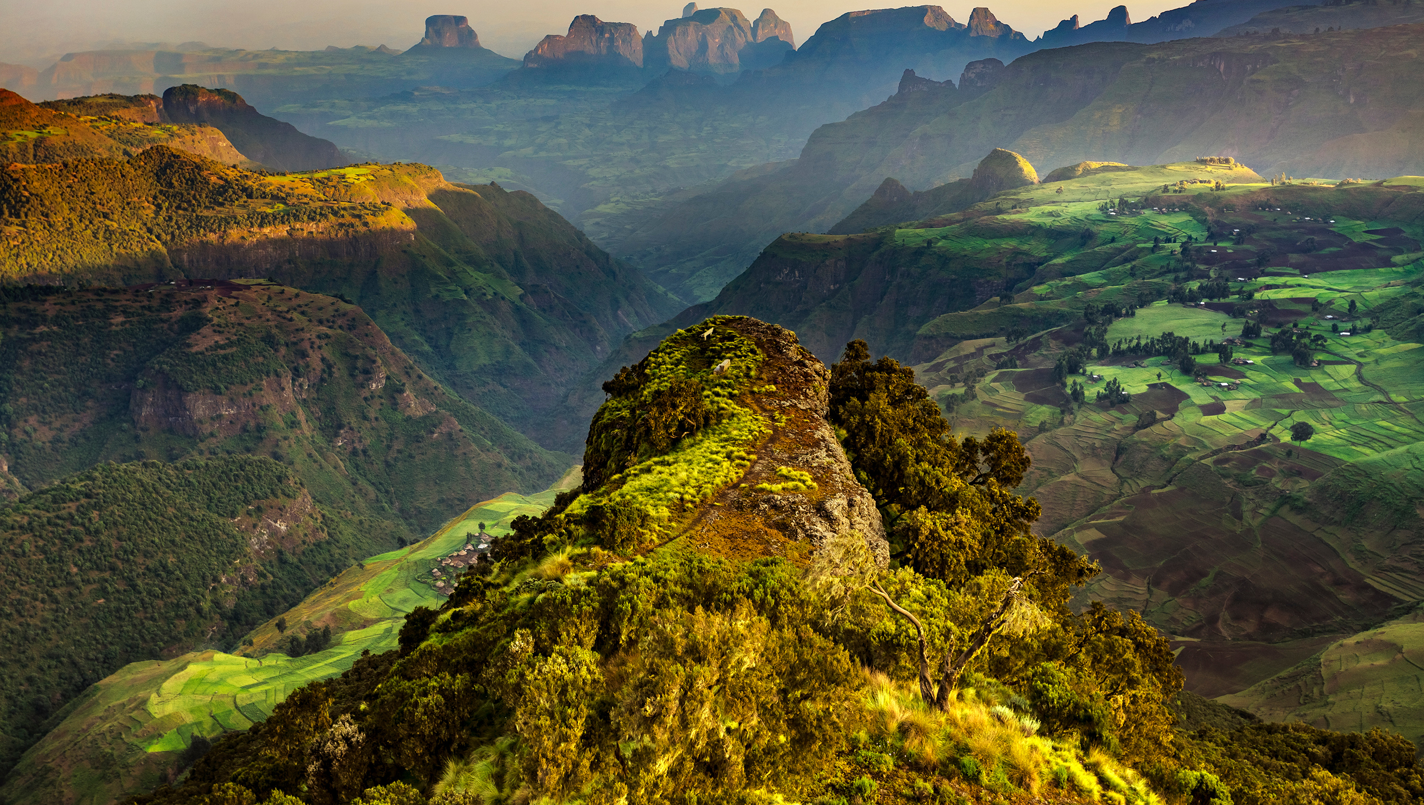
Opening remarks
Dr. Melesse Maryo Selamo
Director General of the Ethiopian Biodiversity Institute
and IPBES National Focal Point in Ethiopia
Simien Mountains National Park – by WitR on AdobeStock

Slide 8
Opening remarks
Abisha Mapendembe
Senior Programme Officer, UNEP-WCMC
Simien Mountains National Park – by WitR on AdobeStock

Slide 9
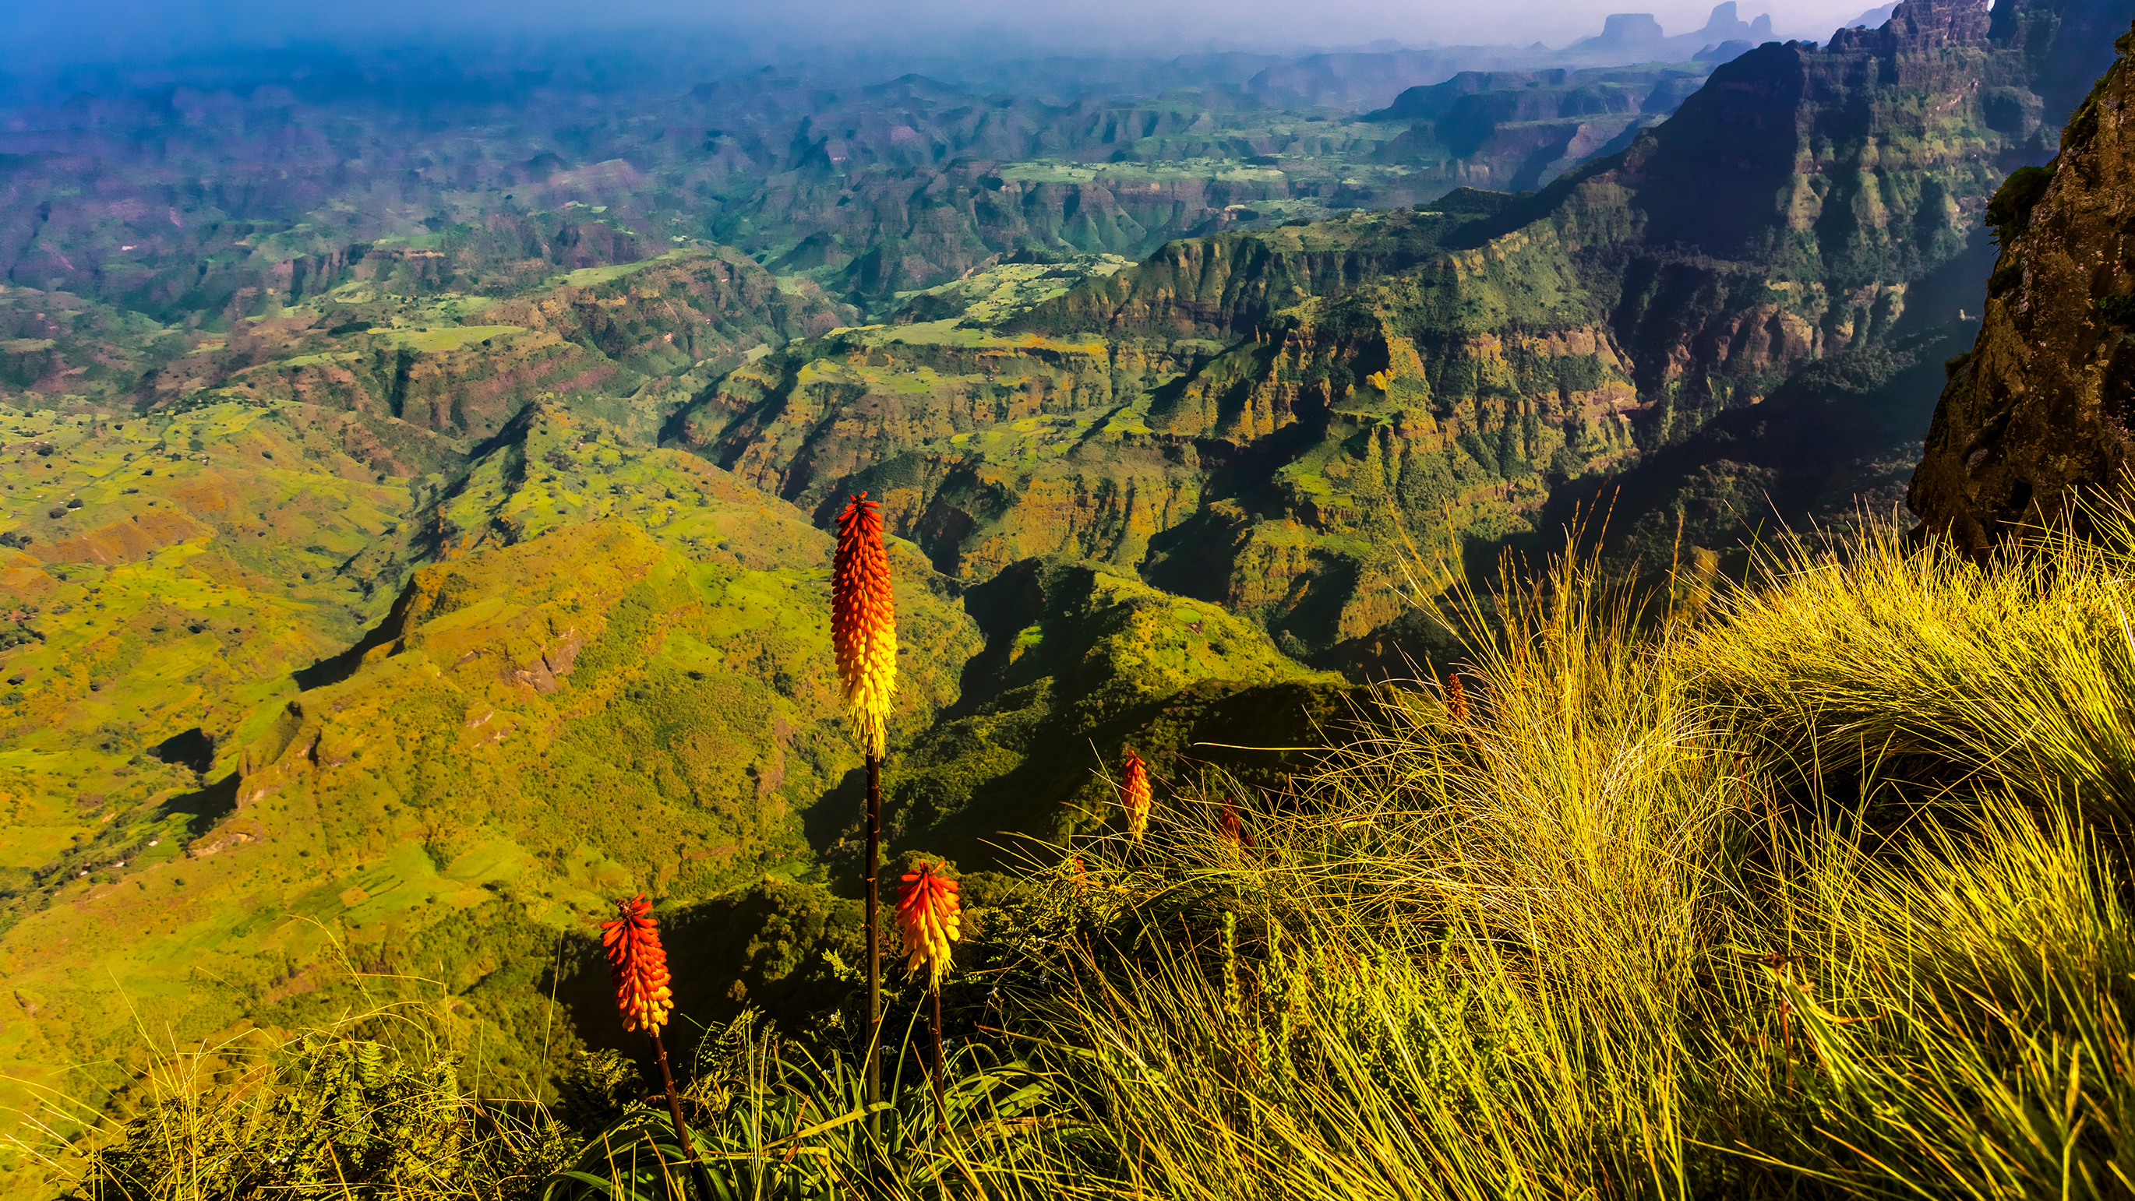
Overview of Ethiopia’s National Ecosystem Assessment Process
Dr. Debissa Lemessa
Coordinating Lead Author, Addis Ababa University
Simien National Park – by WitR on AdobeStock

Slide 10
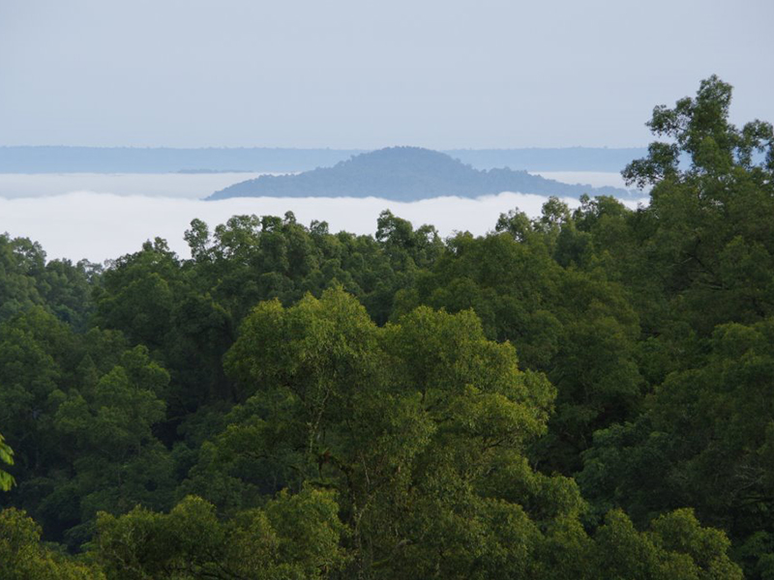
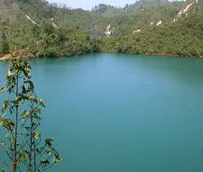
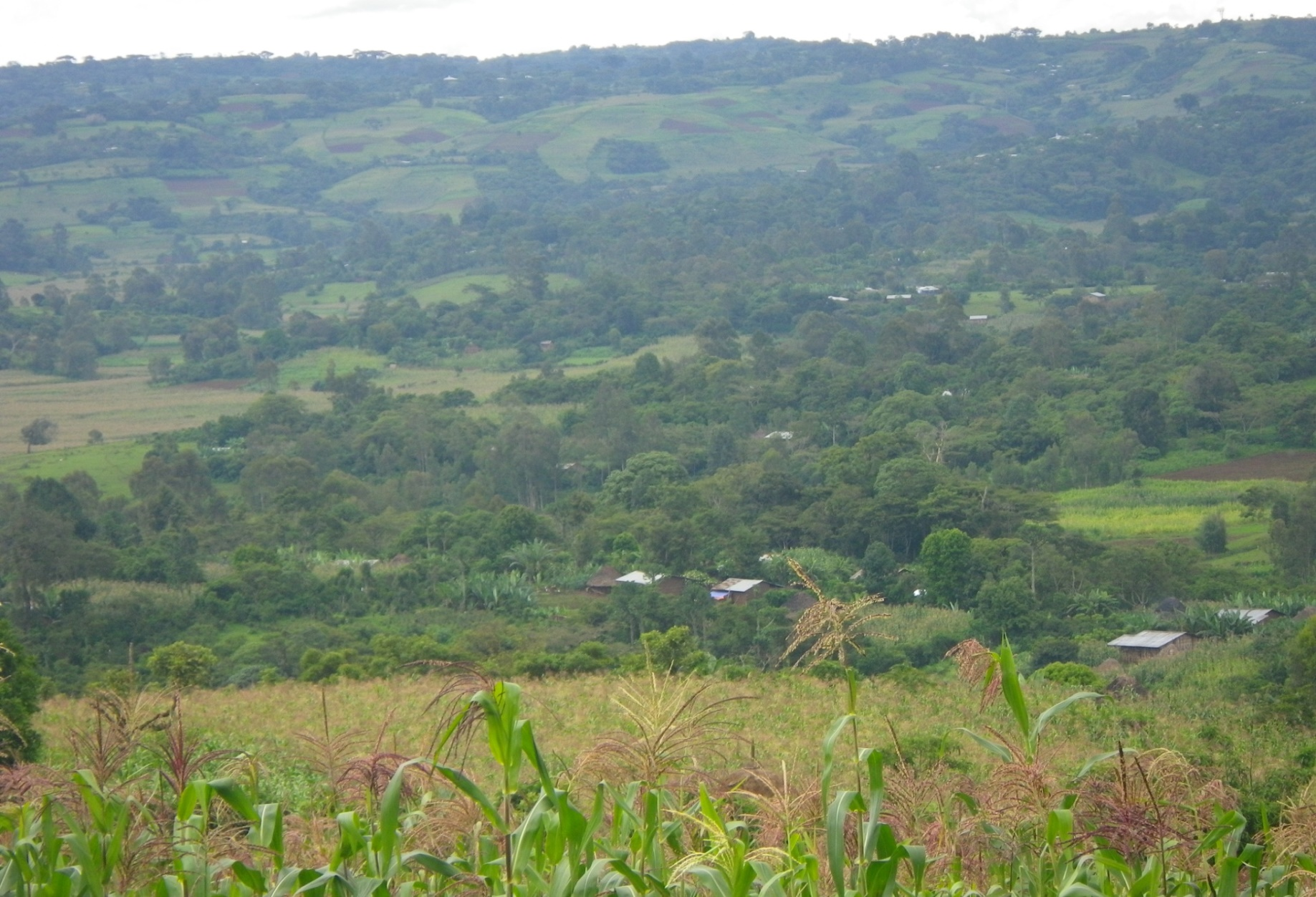
Overview of Ethiopia’s National Ecosystem Assessment Process
Debissa Lemessa (PhD, Associate Prof.)
Addis Ababa University
May 30, 2022

Slide 11
Outline
Introduction
- Why National Ecosystem Assessment (NEA)?
NEA assessment processes

Slide 12
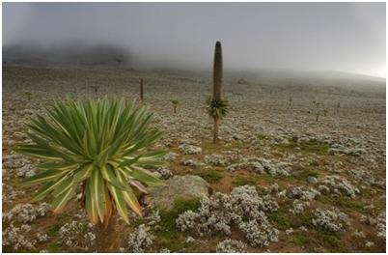
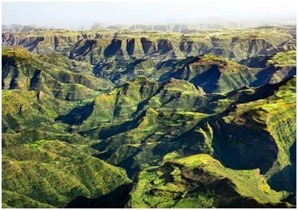

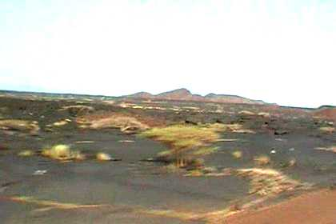
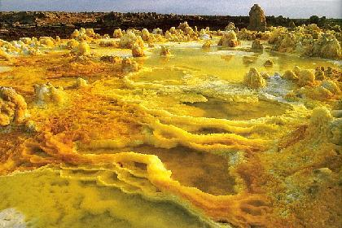
Introduction
Alt. = 4533 m a.s.l.
Ethiopia is rich in ecosystems/high biodiversity:
Different vegetation types
Wide altitudinal variation
- mountainous (roof of Africa, water tower)
- Precipitation and temperature
Different geological formations and soil types
Alt. = 125m b.s.l.

Slide 13
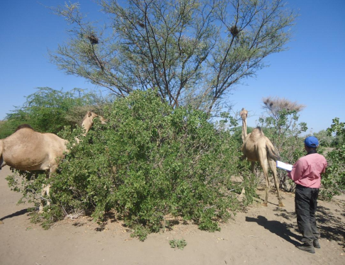
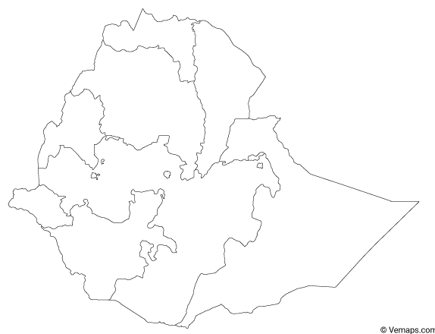
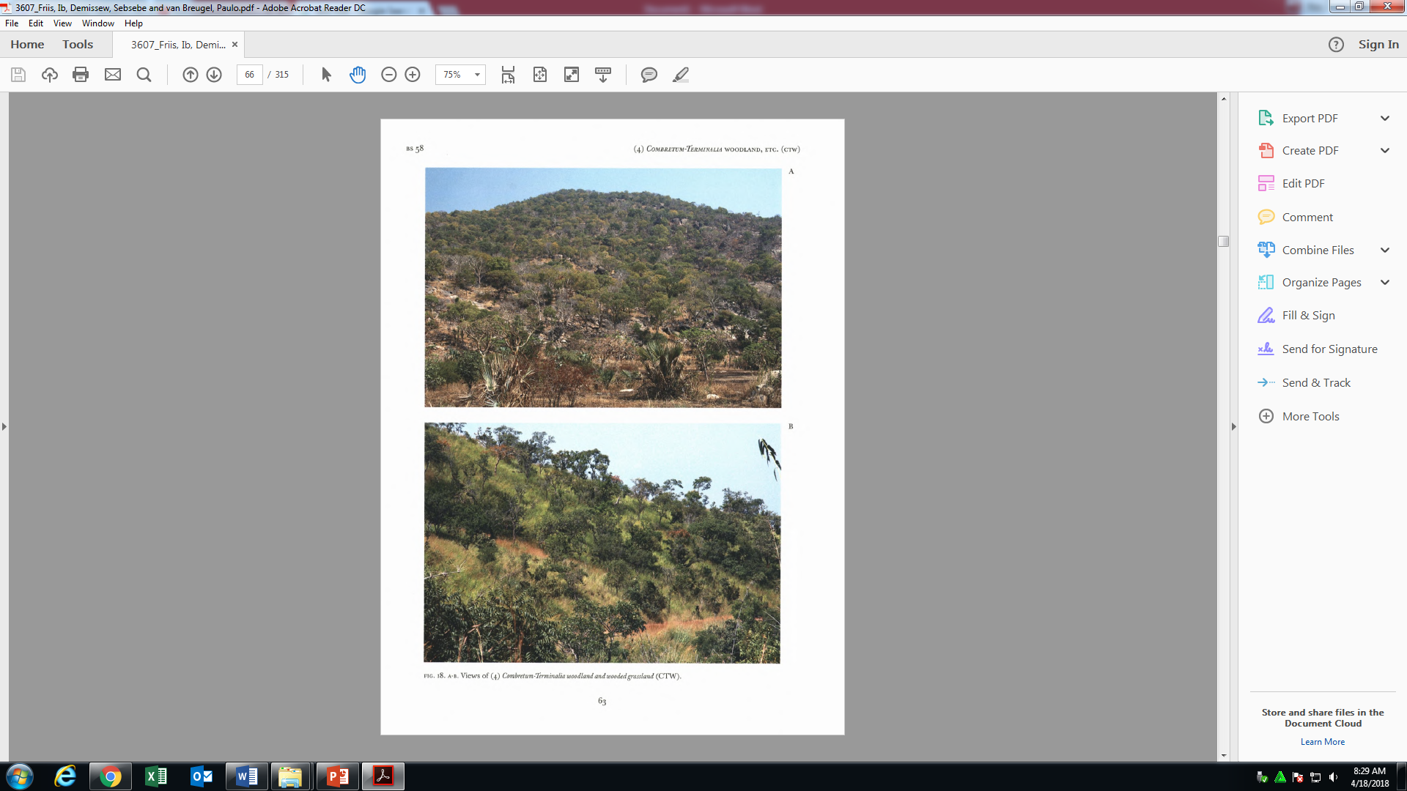
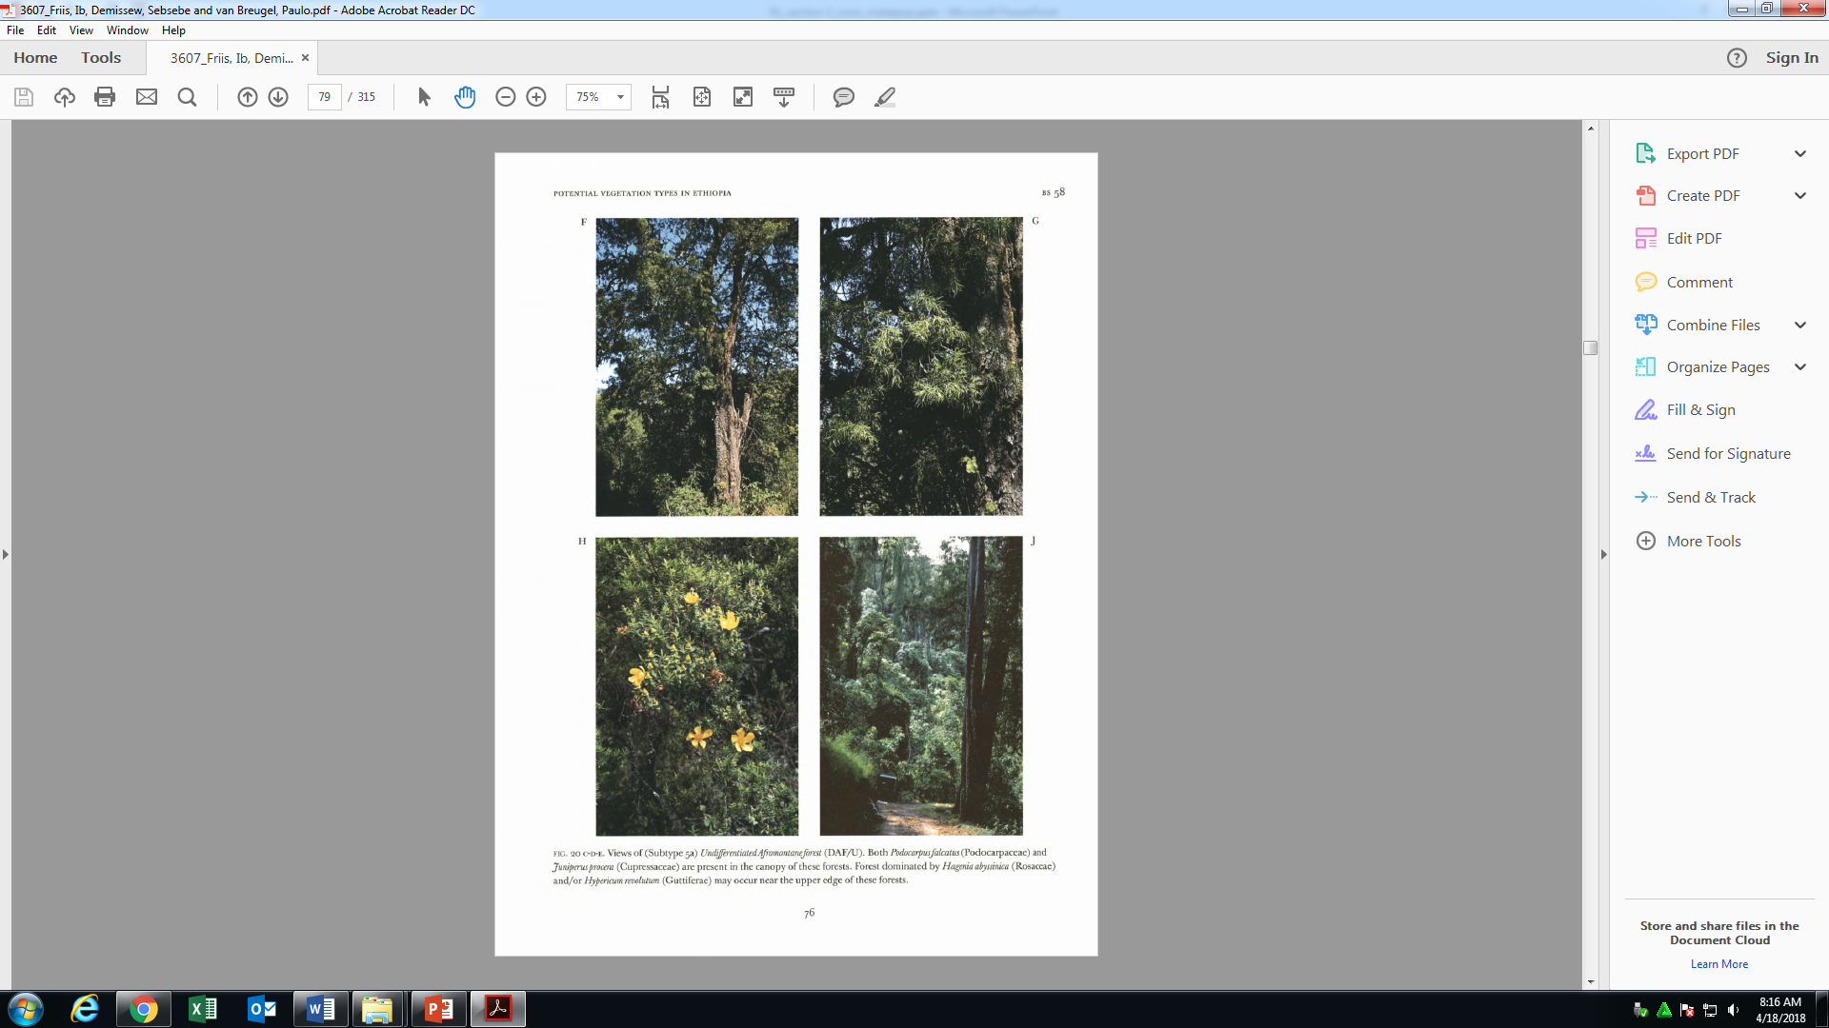
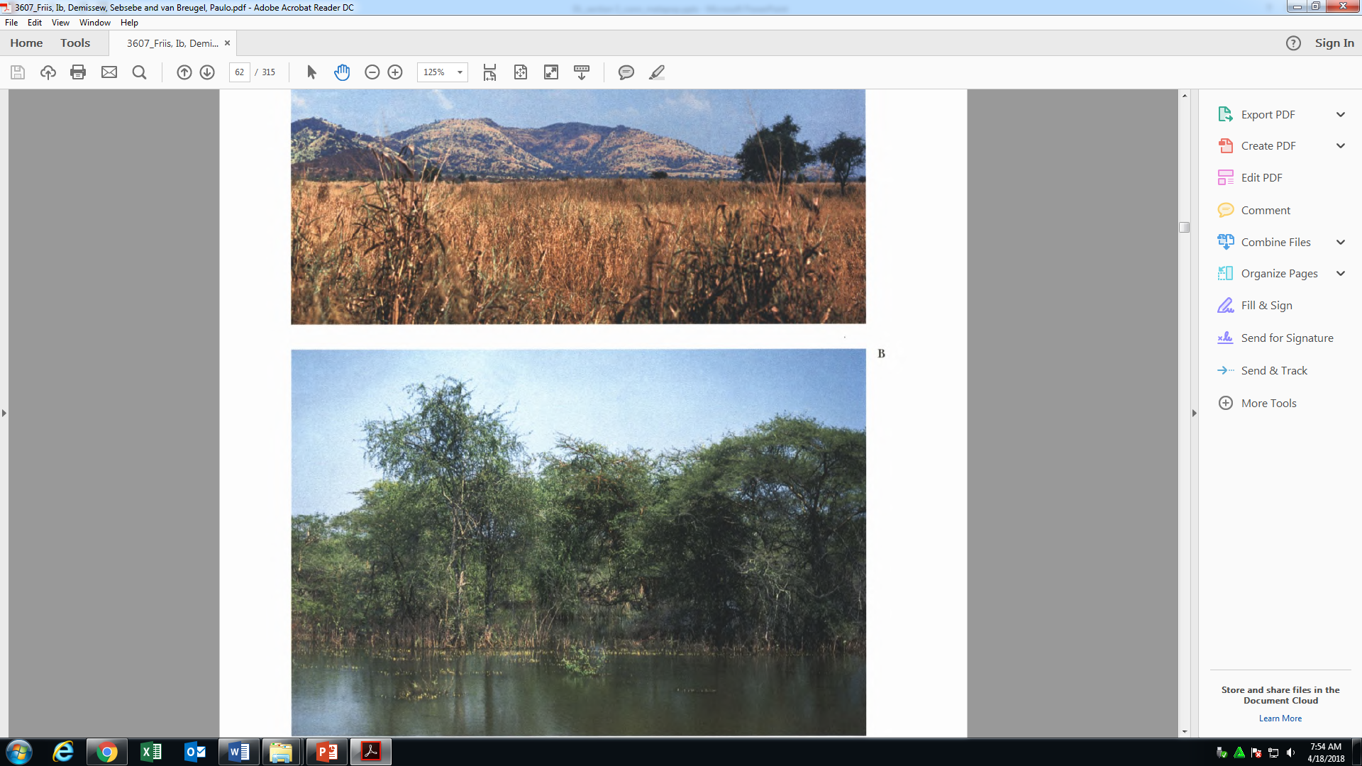
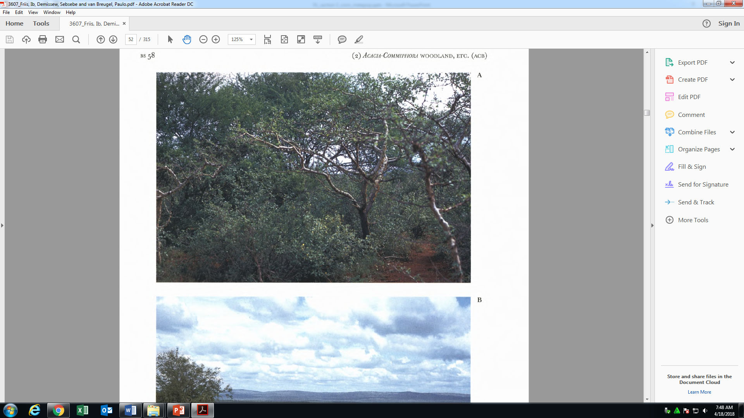
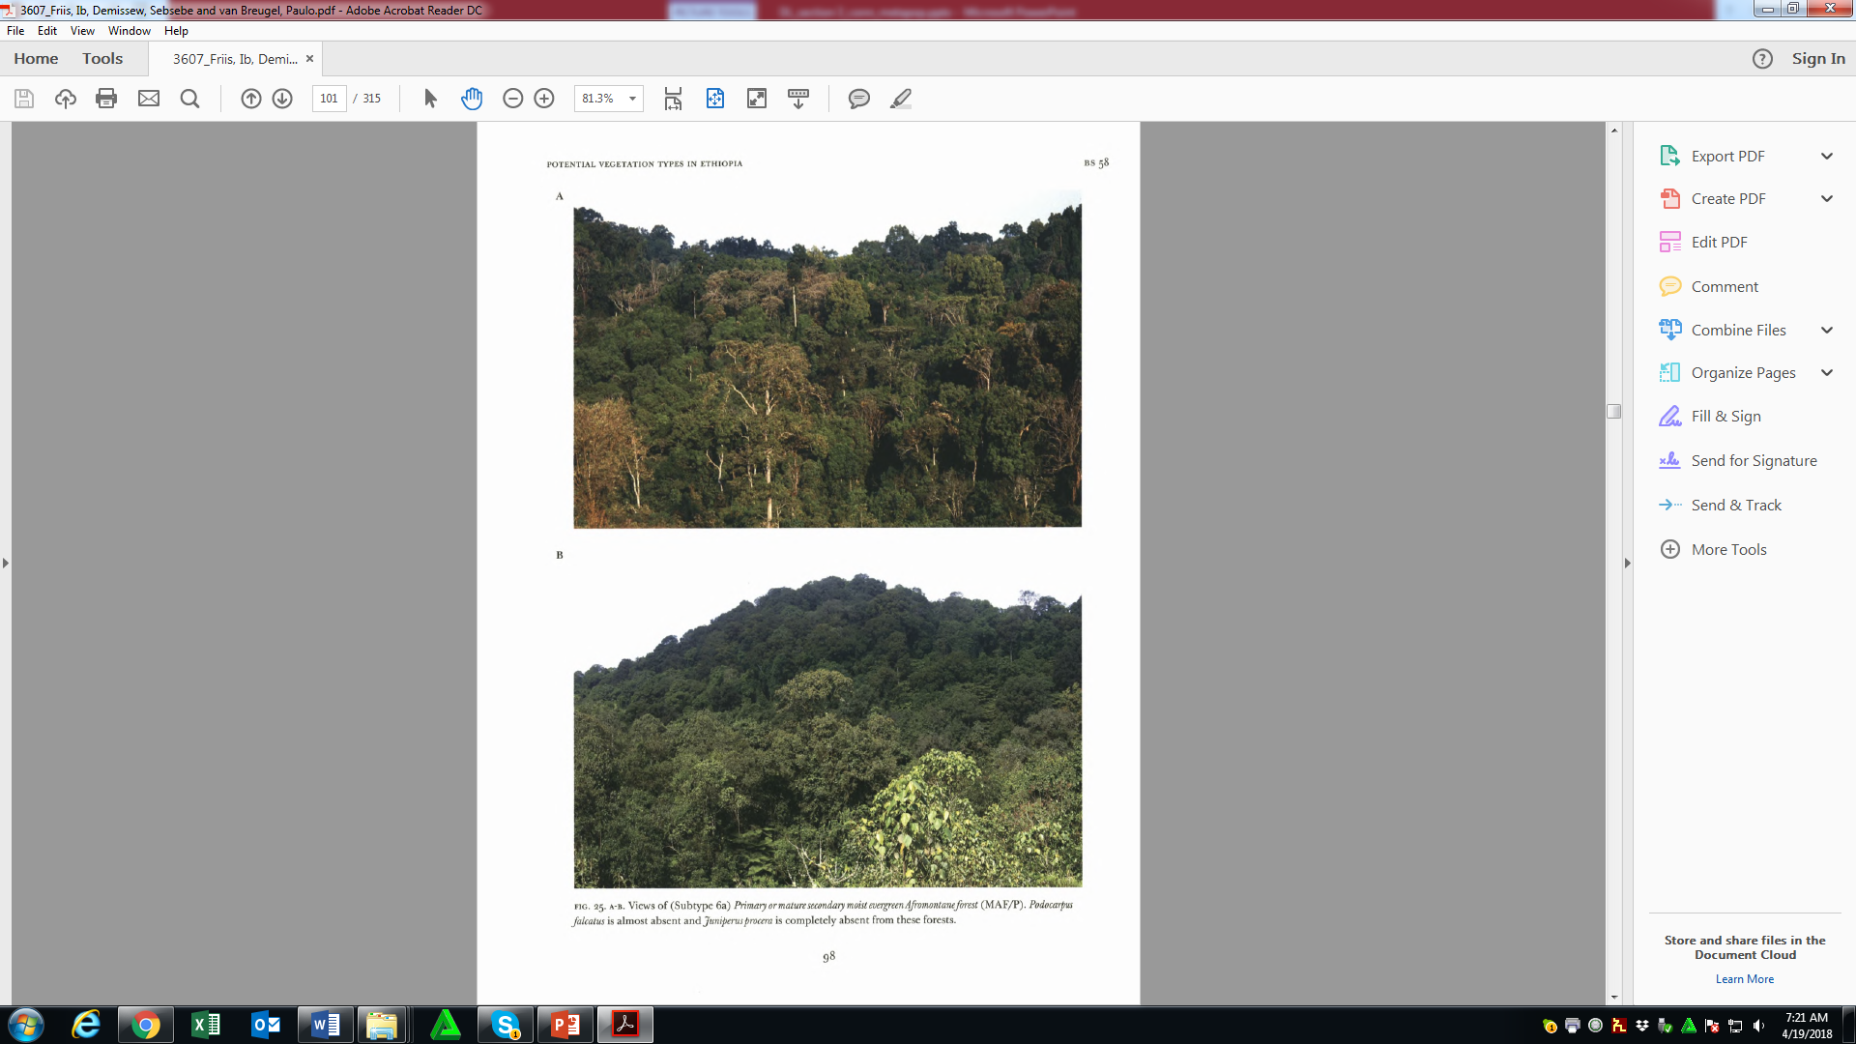
Ecosystems (12), >12 vegetation types

Slide 14
Why NEA?
High diversity of ecosystems, Agroclimatic zones and Agroecosystems
High biodiversity in natural and human-modified systems
High cultural diversity and associated indigenous and local knowledge

Slide 15

Why NEA?
Biodiversity degradation is ever-escalating:
- incompatible governance system?
- policy incoherence (not evidence based), poor
planning, poor knowledge?
- ever increasing number of population?
effective management of the biodiversity resources, the challenges of governances and benefits obtained from nature need adequate evidence/ up to date knowledge and compatible policy

Slide 16

Why NEA?
vital to strengthen the Science-Policy interface and
ensure conservation of biodiversity and improve the
contributions to the human wellbeing
Assumption:
Good policy = f(Evidence + Natural resources*drivers +
opportunities + exogenous factors)
Natural resource base = f(Drivers)

Slide 17
NEA assessment process
Aim:
to assess the status and trends regarding biodiversity and associated ecosystem services and contributions to human wellbeing (good quality of life)
- to strengthen the science-policy interface on biodiversity and
ecosystem services at national level

Slide 18
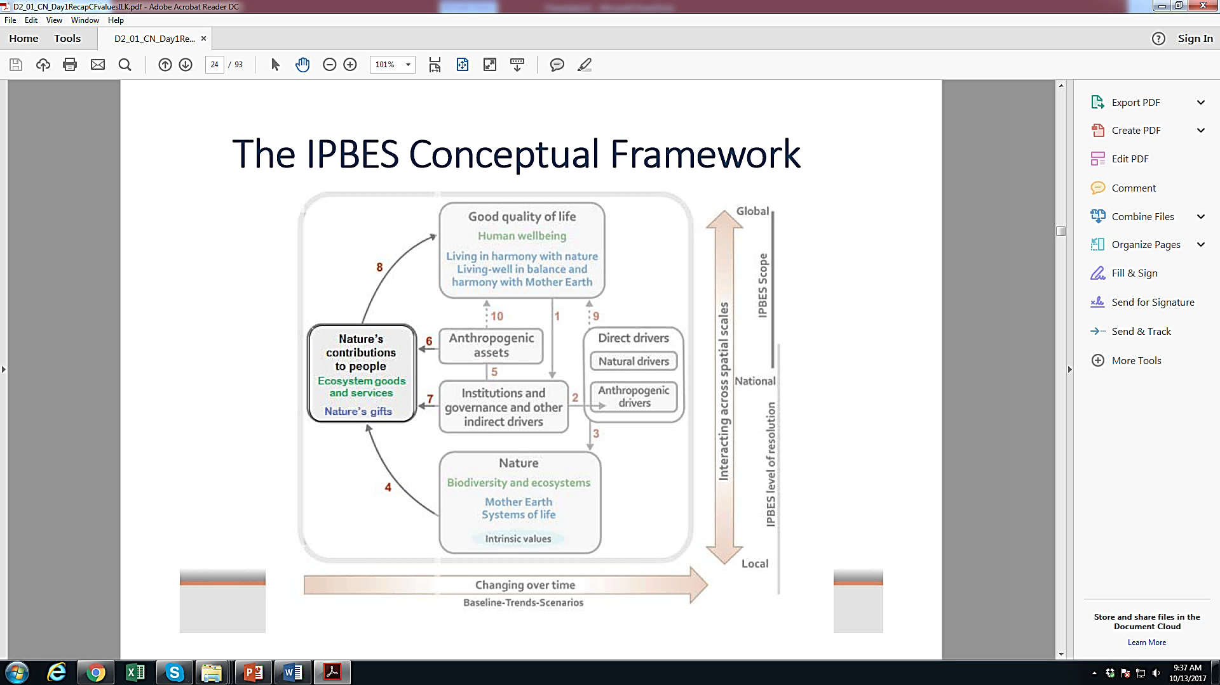
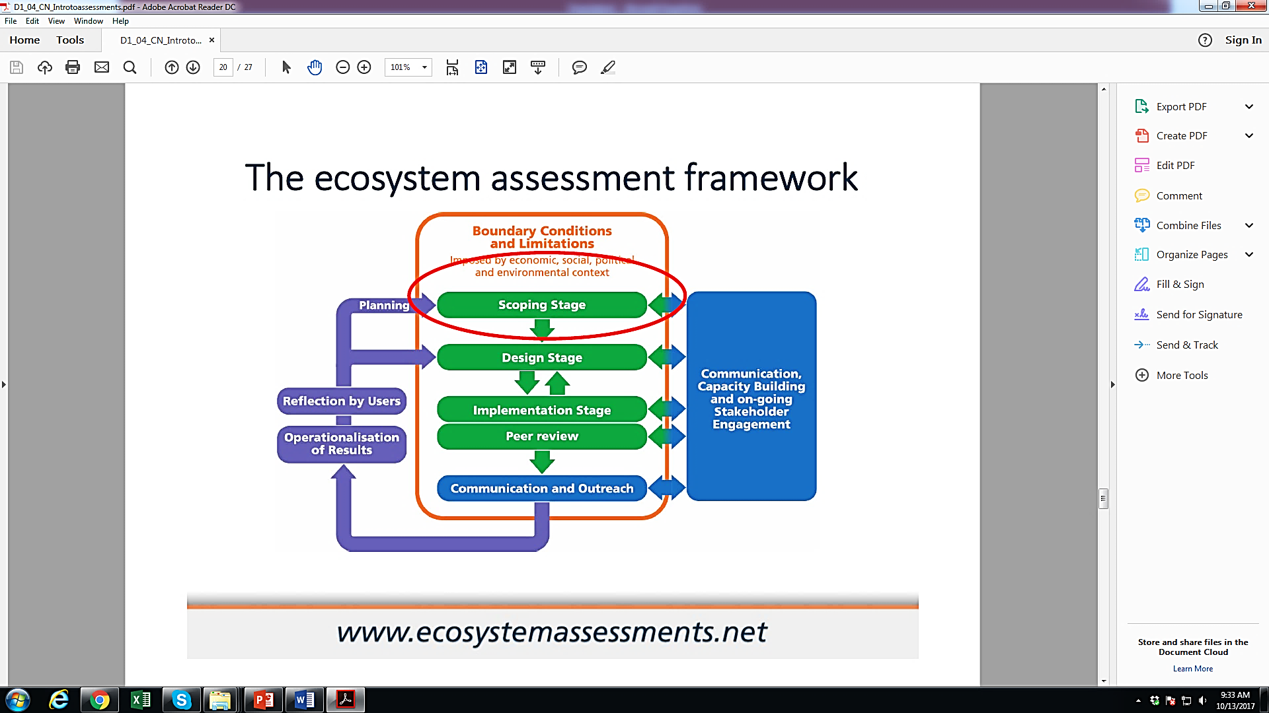
NEA assessment process
Experts were guided by:
a conceptual framework,
and
assessment framework
vital to outline the concepts on the interaction between people and nature, and nature's contributions to people

Slide 19
NEA assessment process
was based on scanning peer-reviewed scientific literature, grey literature and other available knowledge such as indigenous and local knowledge
did not involve the undertaking of new primary research
based on the principles that the findings should be:
policy relevant; not policy-prescriptive
credible, legitimate and relevant

Slide 20
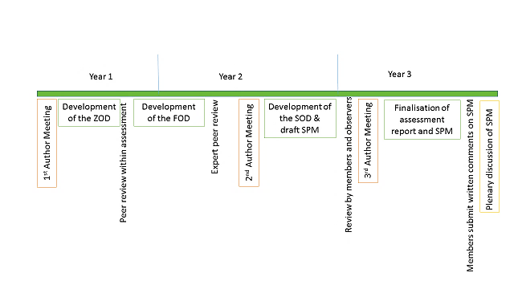
NEA assessment process
2017/2018
2018/2019
2019/2020
Total Budget: 400,000 USD
Summary for Policy Makers (SPM)

Slide 21
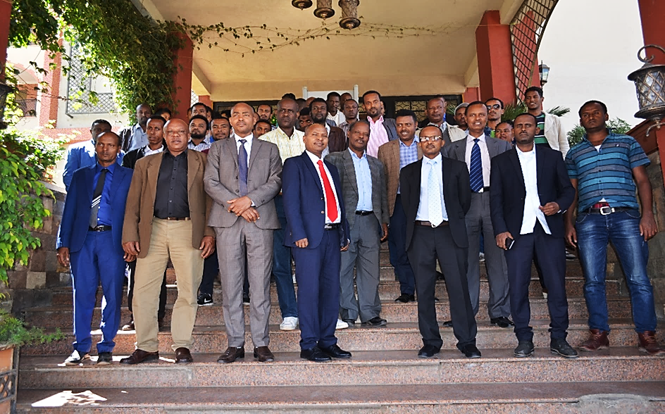
NEA project launched on 16-17 February 2018

Slide 22
One of the critical questions which was raised and discussed during the project launching workshop was
‘What is the current status of biodiversity ?
  - Forest
- Aquatic and wetland
- Range land
- Climate change
- Agroecosystem

Slide 23
NEA assessment process
For the assessment :
- Five broad categories of ecosystems were identified
- Seven key policy relevant questions were drafted
- Authors, editors and external peer reviewers were nominated
using snowball method

Slide 24
NEA assessment processes
For the assessment five broad categories of ecosystems were identified:
1. Mountain (AA, MAF, DAF)
2. Forest and woodland (MAF, TRF, DAF, CTW, ACB, WGG, DSS)
3. Aquatic and Wetland
4. Rangeland (CTW, ACB, DSS etc.)
5. Agroecosystem (C-T-A interactions, Farming systems, ILK)

Slide 25
NEA assessment process
Seven policy relevant questions were identified :
1. What are the status and trends of biodiversity in (Forest and woodland, rangeland, wetland and aquatic, agroecosystem and mountain) ecosystems and the services they deliver in Ethiopia?
2. What are the pressures driving changes in the status and trends of biodiversity in (forest and woodland, rangeland, wetland and aquatic, agroecosystems and mountain) ecosystems and the services they deliver in Ethiopia?
3. How do the biodiversity in forest and woodland, rangelands, wetland and aquatic, agroecosystems and mountain ecosystems and the services they deliver contribute to the national economy and to human well-being?

Slide 26
NEA assessment process
4. What is the state of awareness of key stakeholders (policy makers, managers and media) on biodiversity in forest and woodland, rangeland, wetland and aquatic, and agroecosystems and mountains goods and services and their contribution to human well-being?
5. What is the contribution of indigenous knowledge to conservation and sustainable use of biodiversity in those ecosystems (forest and woodland, rangeland, wetland and aquatic, agroecosystems and mountains)?

Slide 27
NEA assessment process
6. What are the actual and potential impacts of various key policies and interventions on biodiversity in (forest and woodland, rangeland, wetland and aquatic, agroecosystems and mountains) and their contributions to the national economy and human well-being?
7. What are the key policy, governance and institutional arrangement needed for maintaining and improving biodiversity and services in forest and woodland, rangeland, wetland and aquatic, agroecosystem, mountains ecosystems?

Slide 28
Authors, editors and external peer reviewers (Universities, research institutes and others)
NEA assessment processes
 | Authors | Ecosystems
 |  | Forest and Woodland | Mountains | Aquatic and Wetland | Rangeland | Agroecosystem
1 | Coordinating Lead Authors (CLA) | 1 | 1 | 1 | 1 | 1
2 | Lead Authors (LA) | 1 | 1 | 1 | 1 | 1
3 | Contributing Authors (CA) | 3 | 3 | 3 | 3 | 3
4 | Editors | 1 | 1 | 1 | 1 | 1
5 | External peer reviewers | 1 | 1 | 1 | 1 | 1
Total |  | 7 | 7 | 7 | 7 | 7
35

Slide 29
Outputs of NEA
Five NEA documents were produced for five ecosystems and Scenario
A composite book is produced comprising of six chapters (ecosystems)
Four supporting documents were produced:
SPM
National Biodiversity Platform guideline
Communication strategy
Brochure

Slide 30
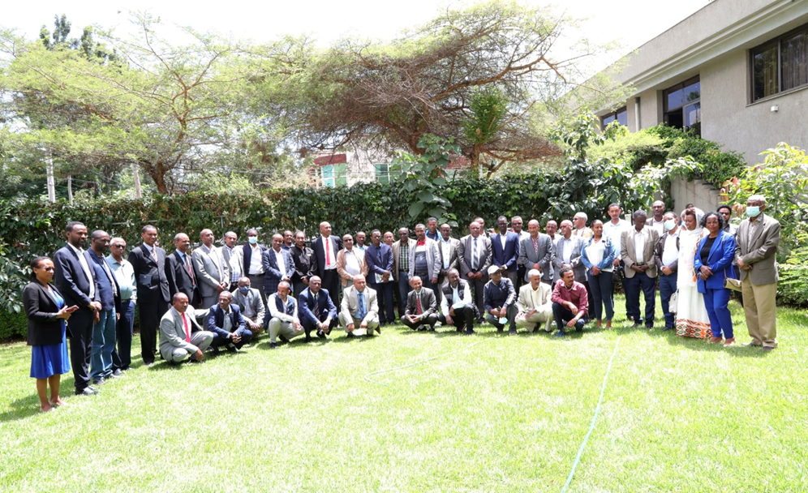
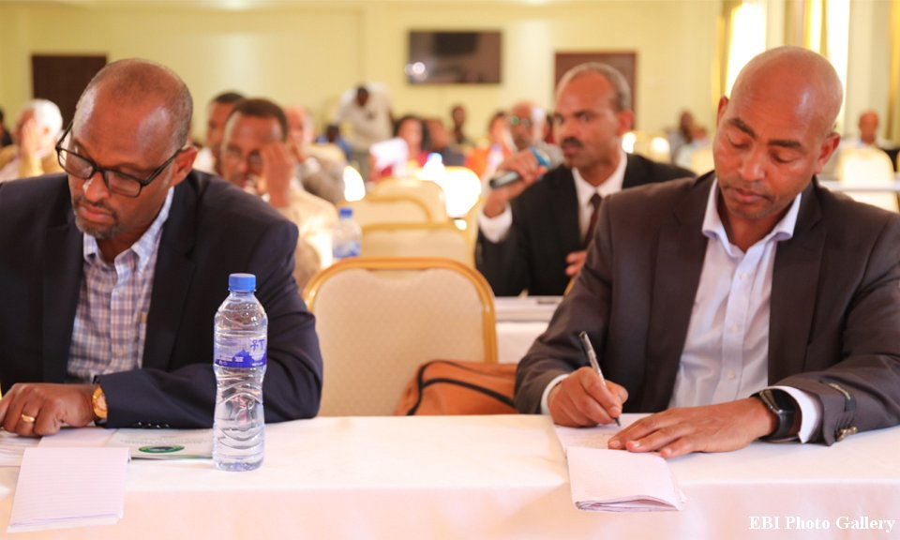
Outputs of NEA
Ethiopian Biodiversity Platform (EBP) established

Slide 31
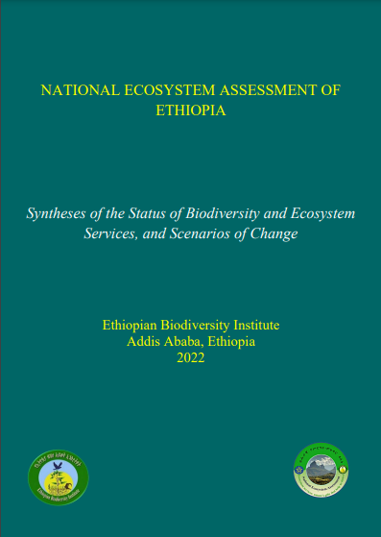
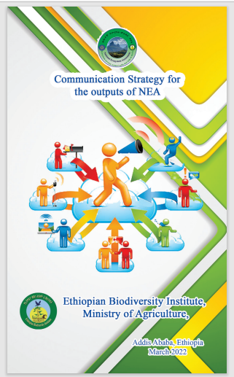
Thank you!

Slide 32
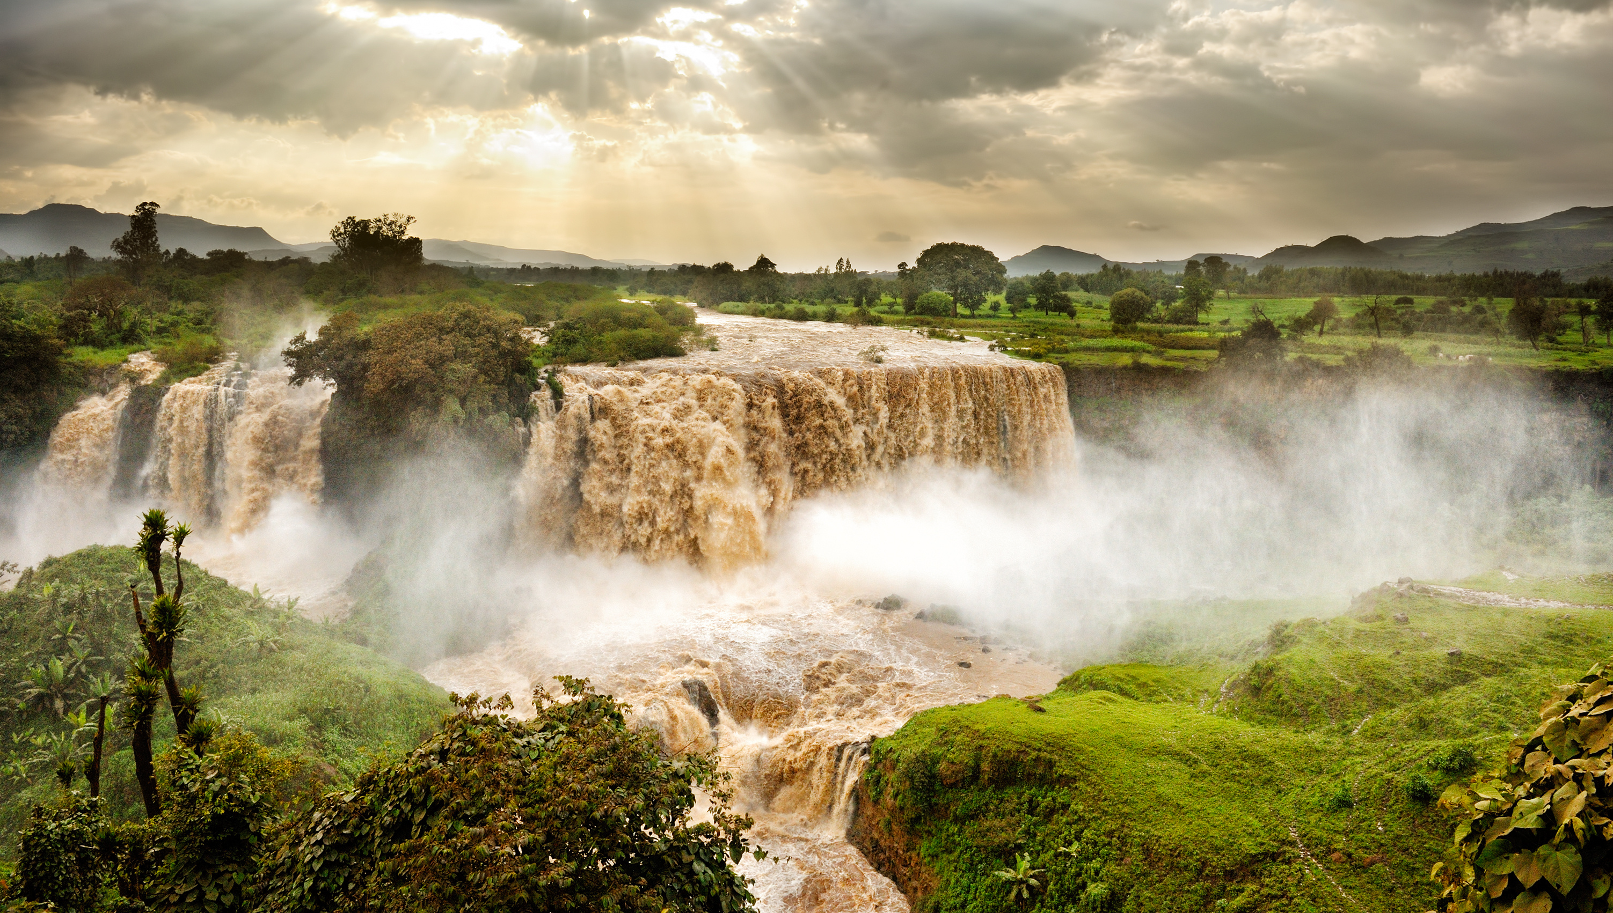
Main Findings of Ethiopia’s National Ecosystem Assessment
Professor Zemede Asfaw
Lead Author and Compiler of the Summary for Policy-Makers, Addis Ababa University
Blue Nile Falls, Tis Issat – by alekosa on AdobeStock

Slide 33



Main Findings of Ethiopia’s National Ecosystem Assessment (Eth-NEA)
Zemede Asfaw (Professor)
Addis Ababa University
May 30, 2022

Slide 34
Presentation Outline
Brief Background on Ethiopia
Aims and Expected Outputs of the NEA
The Scope of the NEA
The Main Findings of the NEA
  Biodiversity & ecosystems
  Policy and institutional framework-related strengths and gaps
    Strengths and gaps
    Policy and institutional framework
    Policy and institutional perspectives
  Indications of the scenario analysis
    Scenario analysis seen with the assessment conclusions

Slide 35
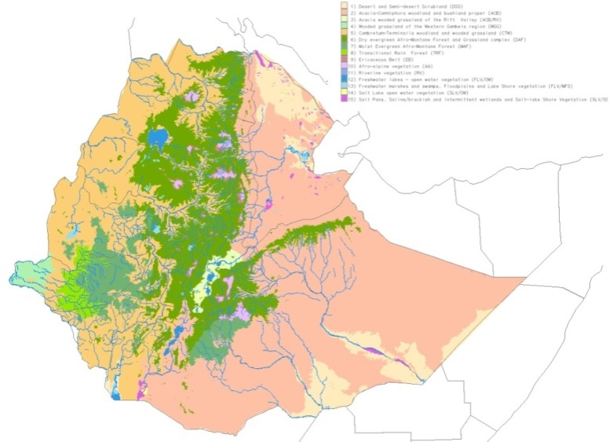
Brief Background on Ethiopia
Horn of Africa
Diverse topographic features & environmental variations
Ecological/agro-ecological diversity
  Two of the 36 global biodiversity hotspots
  A Vavilovian centre of crop origin & diversity
Natural biological assets with richness & uniqueness
  Large number of species with endemic & rare animal & plant species
  Combines biodiversity wealth with ecosystems, socio-cultural diversity & ILK
  Expansive rangelands and agricultural landscapes supporting crop cultivation, animal husbandry & other activities

Slide 36
The Aims of the NEA & Expected Outputs
The NEA was undertaken with the aims to:
  Develop an up-to-date critical synthesis of knowledge on biodiversity and ecosystem services,
  Assess the linkages of biodiversity and ecosystems with people,
  Address the country’s needs for intervention on specific policy-relevant questions, and
  Strengthen the science-policy interface.
The expected outputs were
  A book presenting the assessment results
  (a syntheses on status of biodiversity & ecosystem services &
  scenarios of change)
  A Summary for Policy Makers (a condensed form of the book),
  A National Biodiversity Platform (for guiding future processes)

Slide 37
The Scope of the NEA
  The assessment has
    Aimed at covering
    the status & trends;
    pressures & drivers,
    policy & institution in biodiversity & ecosystem services
    Reviewing the ecosystem classification
    the widely accepted approach based on vegetation types (Commonly 12 types) through discussion among experts & stakeholders
    Addressing the five broad ecosystem-clusters as assessment targets: Mountain, Forest & Woodland, Aquatic & Wetland, Rangeland &Agricultural ecosystems

Slide 38
The Key Findings of the NEA
  Biodiversity and ecosystem status in Ethiopia
  The NEA is the first of its kind for Ethiopia, and revealed information on:
    Contributions of biodiversity & ecosystem services,
    Status & trends of change on the biodiversity resource base;
    Pressures & drivers of change;
    Knowledge & awareness;
    Policy & organizational/institutional matters and gaps
    Biological significance & uniqueness

Slide 39
The Key Findings of the NEA
  Some basic facts about the major ecosystems NEA
Ecosystem Types/Cluster | Area (in km²) | Area (% of country’s area) | Description
Mountain | 3000-6500 | 0.27-0.59 | Landmass rising above the surrounding areas
Forest and Woodland | 173,500 - 300,000 | 15.7-27 | forest lands and woodlands in all landscapes
Aquatic & Wetland | 9318 | 0.844 | wetlands and water bodies
Rangeland | 767, 000 | 69 | Uncultivated land, provides forage & pasture for grazing & browsing animals
Agroecosystem | 105,974-242,880 | 9.6-22 | Agricultural landscape (croplands, homegardens, pastoral areas)
  The assessment revealed,
  Ecosystems are degrading, vulnerable & biodiversity is declining:
      ⇒ Land-use changes, overgrazing, receding of lakes, habitat & species loss
  Evident gaps in policies & institutional setup exist
  A very weak since-policy interface

Slide 40
  Biodiversity & ecosystem: status, changes, drivers, knowledge
  The Mountain Ecosystem
  Very large area of land hosting important vegetation types, rich flora & fauna but degrading & degraded in many places
  Declining in area coverage & biodiversity quality & quantity
    Most of the endemic flora & fauna
    assigned critically endangered
    status by the IUCN Red List Criteria
    Steep slopes encroached by
    agriculture (cultivation, overgrazing)
    Most sensitive & fragile, highly
    vulnerable to climate impacts
    Drivers: land-use changes, climate
    variability, population pressure
    Limited research & documentation on BES

Slide 41
  Biodiversity & ecosystem: status, … (contd.)
  The Forest & Woodland Ecosystem
  A vast area, various vegetation types,
  distributed in agro-climatic gradients
  From the woodlands of lowlands to
  high mountain tropical forests
    Covers 15-27% of the total
    area of all the ecosystems
    Vulnerable as natural habitats
    deteriorate & decline in floral &
    faunal diversity due to land-use changes, deforestation
    The embedded protected areas are acing anthropogenic pressures
    General lack of compliance with & paucity in implementing existing policies & enforcing laws/regulations
Land-use & land cover map

Slide 42
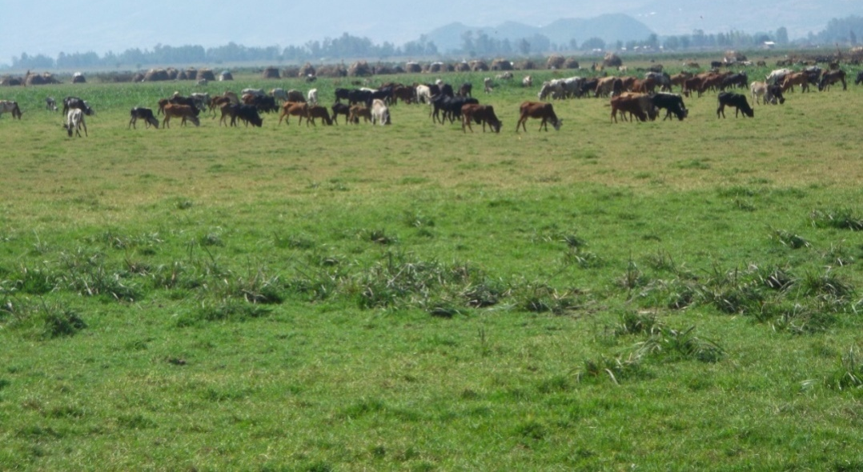
  Biodiversity & ecosystem: status, … (contd.)
  The Aquatic & Wetland Ecosystem
  A biodiversity hotspot:
    ~10% of the Ethiopian
    floral diversity,
    habitats for ~25% of
    the avifauna,
    hosts several megafauna
  Rapidly declining with the
  biodiversity of the wild fauna & flora
    The ecosystem goods & services &
    associated ILK prone to vanish
    A host of direct and indirect rivers:
  Absence of a national policy that
  recognizes values & benefits of wetlands and aquatic resources

Slide 43
  Biodiversity & ecosystem: status, … (contd.)
  The Rangeland Ecosystem
  Largest land area (69%), shrinking since the 1960s
  A number of threatening factors to BES & ILK
  Curtailed traditional seasonal mobility that led to vegetation cover loss
  Deterioration aggravated by diverse drivers:
    Population pressure, privatization land enclosures, bush encroachment, sedentarization, land-use change,
    weakening customary institutions, change & human pressure
  Government focus on poverty
  reduction
    not proper attention to
    biodiversity & ecosystem
    protection

Slide 44
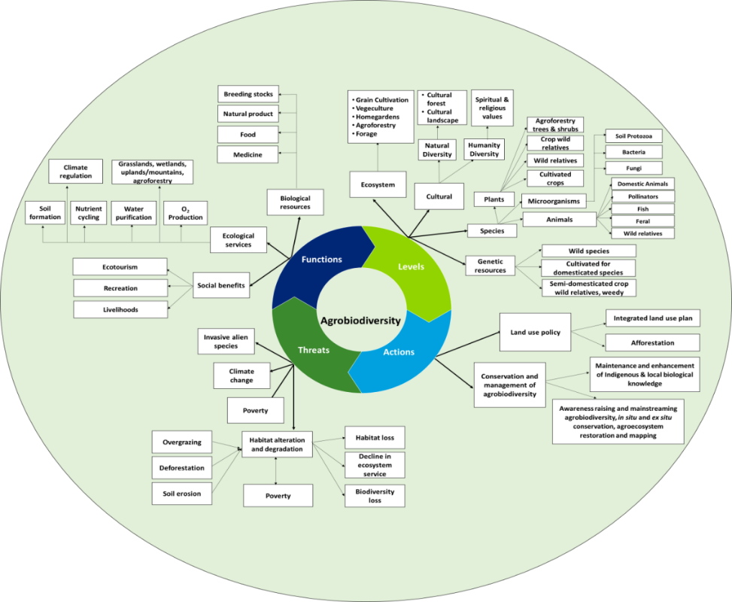
  Biodiversity & ecosystem: status, … (contd.)
  The Agroecosystem
  Covers about 9-22% of the
  ecosystems
  Source of food for the
  population and employment
  Its agrobiodiversity & the
  services it provide are threatened
  by natural and anthropogenic drivers:
    Unsustainable utilization of resources
    (overexploitation, excessive use of nutrients)
    Climate change (drought, flood, acidification,
    salt accumulation, soil erosion, water depletion)
    Invasive alien species
Levels, functions, threats & actions

Slide 45
  Policy & Institutional Framework-related … (contd.)
Strengths: Basic policies, strategies & institutions in place
Policies, strategies, proclamations, programs and plans
    Environment, Biodiversity, Forest development policies …
    Climate Resilient Green Economy Strategy …
    Genetic resources and community knowledge proclamation …
    Government commitment to the cause of conservation
    Putting in place appropriate institutions
    Establishment of protected area system (parks, protected forests, others)
    Formulation and execution of National Biodiversity Strategy & Action Plans (NBSAPs)

Slide 46
  Policy & Institutional Framework-related … (contd.)
Strengths: Basic policies, strategies … (contd.)
    Options/opportunities & knowledge
    Richness in biodiversity and associated ecosystem services
    A very rich ILK that has developed and accumulated over millennia
    Biodiversity wellbeing & healthy ecosystem/agroecosystem as key factors for Ethiopia’s:
      Growth and Transformation drive
      Climate Resilient Green Economy Strategy

Slide 47
  Policy & Institutional Framework-related … (contd.)
Gaps
    Biodiversity & ecosystems face pressures & policy gaps
    Pressures identified:
    Huge pressure & drivers on ecosystems (mountain, forest, woodland, aquatic & wetland, rangeland) & protected areas
    Policy gaps indicated:
    Absence of a comprehensive land-use policy
    Inadequacy of legal frameworks (forest, rangeland, wetland): patchy, focus, tools
    Policy design, implementation & legal frameworks
    Institutional gaps
    Poor inter-sectoral coordination, synergy, law enforcement
    Frequent shifting of institutional mandates & working relations

Slide 48
  Policy and Institutional Perspectives
  Main areas in need of policy and strategy attention
    Documentation for more data
    Restoration, rehabilitation of ecosystems & biodiversity
    Policies: adjusting, exploring, checking coherence
    Science-informed land-use policy almost all ecosystems
    Systems and mechanisms for:
    Meeting the post-2020 Global Biodiversity Framework & alignment with NBSAP
    Implementing biodiversity goals & targets
    Action on invasive alien species
    Conservation of marginal lands, wetlands, forests & woodlands.
    Optimal execution of Climate Resilient Green Economy Strategy

Slide 49
  Policy and Institutional … (contd.)
    Better Natural resource management in all the five ecosystems
    Optimal resource utilization with sustainability
    Options for environmental marketing (water, biodiversity, carbon & other resources)
    Options for valorization of new forest products, enhancing forest & woodland conservation and sustainable utilization
    Plausible interventions to address the challenges:
    Training, awareness-raising, implementation of outreach programmes, knowledge management system
    Research on biodiversity & ecosystem services
      Knowhow on payment for ecosystem services (PES)
  ⇒

Slide 50
  Policy and Institutional … (contd.)
    Engage & empower local communities
    Pastoral-friendly rangeland policy
      Building resilient livelihoods, maintenance of the cultural, historical & economic characteristics of the system
      A clear pastoral land tenure system & land-use policy framework
      Sustenance of productivity of the rangeland ecosystem.
    Measures for excessive population growth
    Implementation of global/regional conventions, treaties & targets at local & national levels

Slide 51
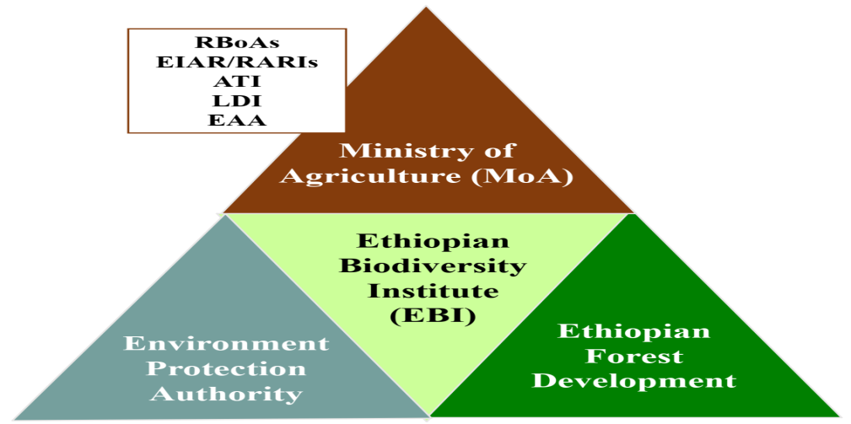
  Institutional Arrangement, Collaboration & Governance
  There is a need:
      for Improved institutional setups
      to enhance working relations
      to avoid mandate overlaps
      for a higher level governance system
      for biodiversity
      Strengthening informal institutions
      that promote wise resource use norm
      and conservation

Slide 52
  Indications emerging from the Scenario Analysis
  Scenario analysis was carried out based on
      The Assessment findings and Expert judgment
    Five plausible scenario archetypes were identified:
      The business-as-usual (future from historical)
      The food first fast track economic growth (economic optimism)
      The green growth (environmental optimism)
      The policy reform (uncertainty), and
      The regional integration model (peace dividends)

Slide 53
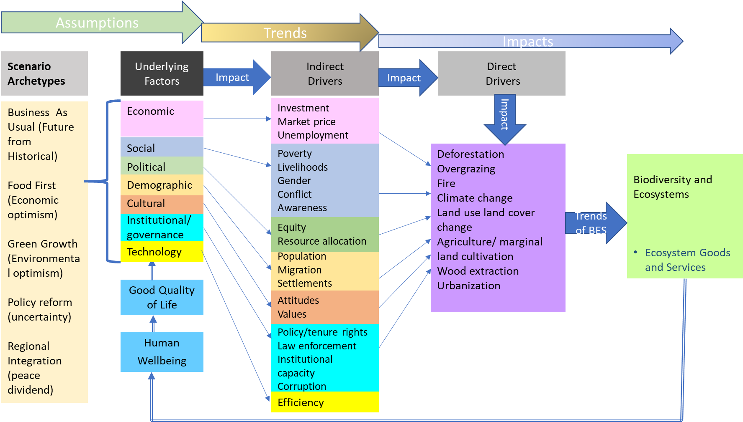
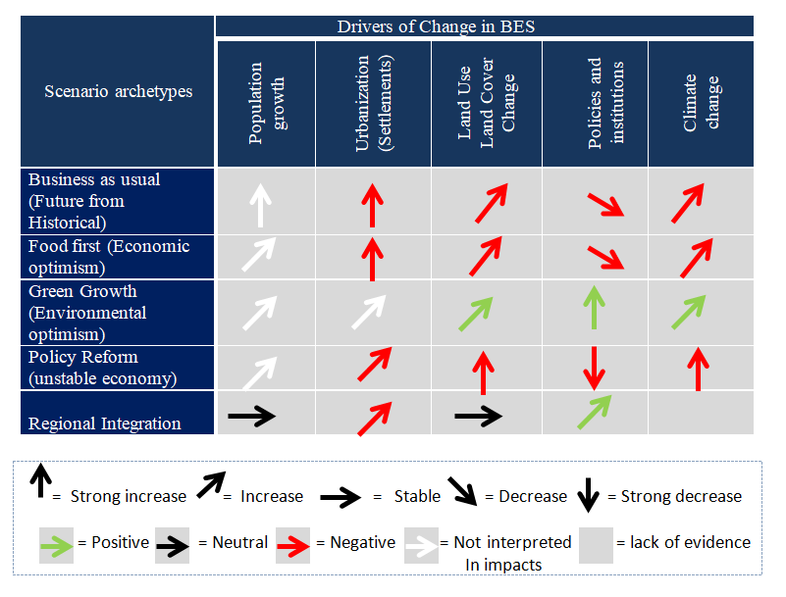
  Indications emerging from the Scenario … (contd.)
Conceptual framework
  How changes impact biodiversity, ecosystems & ecosystem goods & services
  Trends & impacts of each archetype
  underlying factors
  indirect drivers
  Direct drivers
A conceptual framework for the analysis of scenarios
1.Trend in drivers /Urbanization, Land-use/land
cover change, Economic
policy and institution,
Climate change/
  The green growth has better performance under all drivers & is followed by regional integration

Slide 54
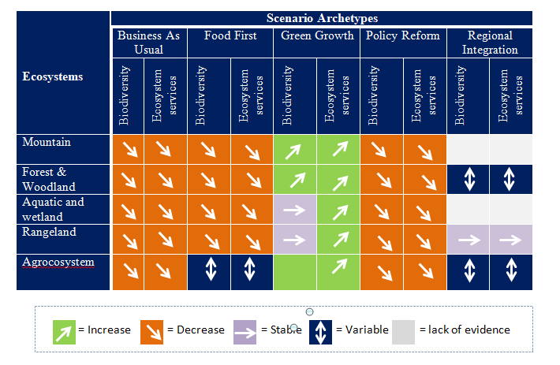
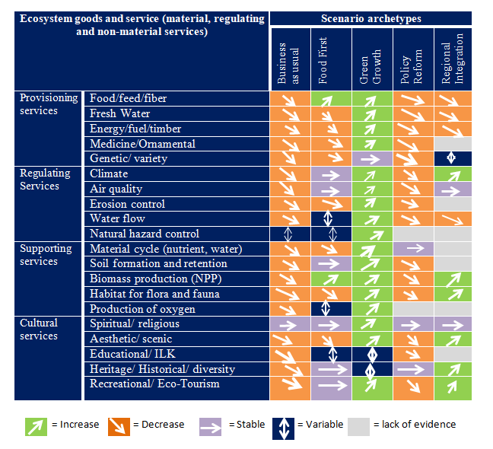
  Indications emerging from the Scenario … (contd.)
2.Trend in biodiversity and
ecosystem services
  Better biodiversity and ecosystem
  services are expected to increase
  in all ecosystems under the green
  growth future
3.Trend in ecosystem goods and
services
  Almost all ecosystem services considered in the assessment increase under the green growth future
  Second best is the regional integration future
  Business-as-usual, policy reform, food first lead to deterioration in ecosystem services

Slide 55
  Convergence of Assessment Conclusions &
  Scenario Analysis
A strong wake-up call to invigorate sustainable conservation interventions
  Exploring policies, plans, arrangements, collaborations
  Effective impact assessment, evaluation, monitoring
  Multiple knowledge systems to address gaps
  Transforming people’s engagement with BES as a centrepiece duty
  Synchronization/alignment of national policy issues with relevant regional/sub-regional & global goals/targets:
    The Post-2020 Global Biodiversity Framework,
    The 2050 Vision for Biodiversity (“Living in harmony with nature”),
    The African Agenda 2063 (biodiversity conservation, ecosystems, genetic resources)

Slide 56
  Convergence of Assessment Conclusions &
  Scenario … (contd.)
Most promising & impactful scenario option
  The Green Growth model
  Green Growth offers a better option for the future of BES in all the five broad ecosystems of Ethiopia
  The regional integration model comes in the second place
  Ethiopia’s Climate Resilient Green Economy Strategy is in good accord with the Green Growth Model
    Ethiopia is already working on many of the policy and institutional issues; the way forward is expected to accelerate and aculeate quickly.

Slide 57
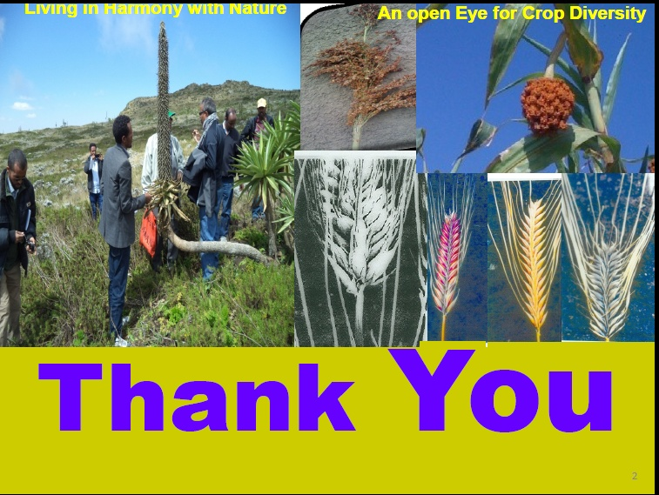

Slide 58

Q&A
@Alexander

Slide 59
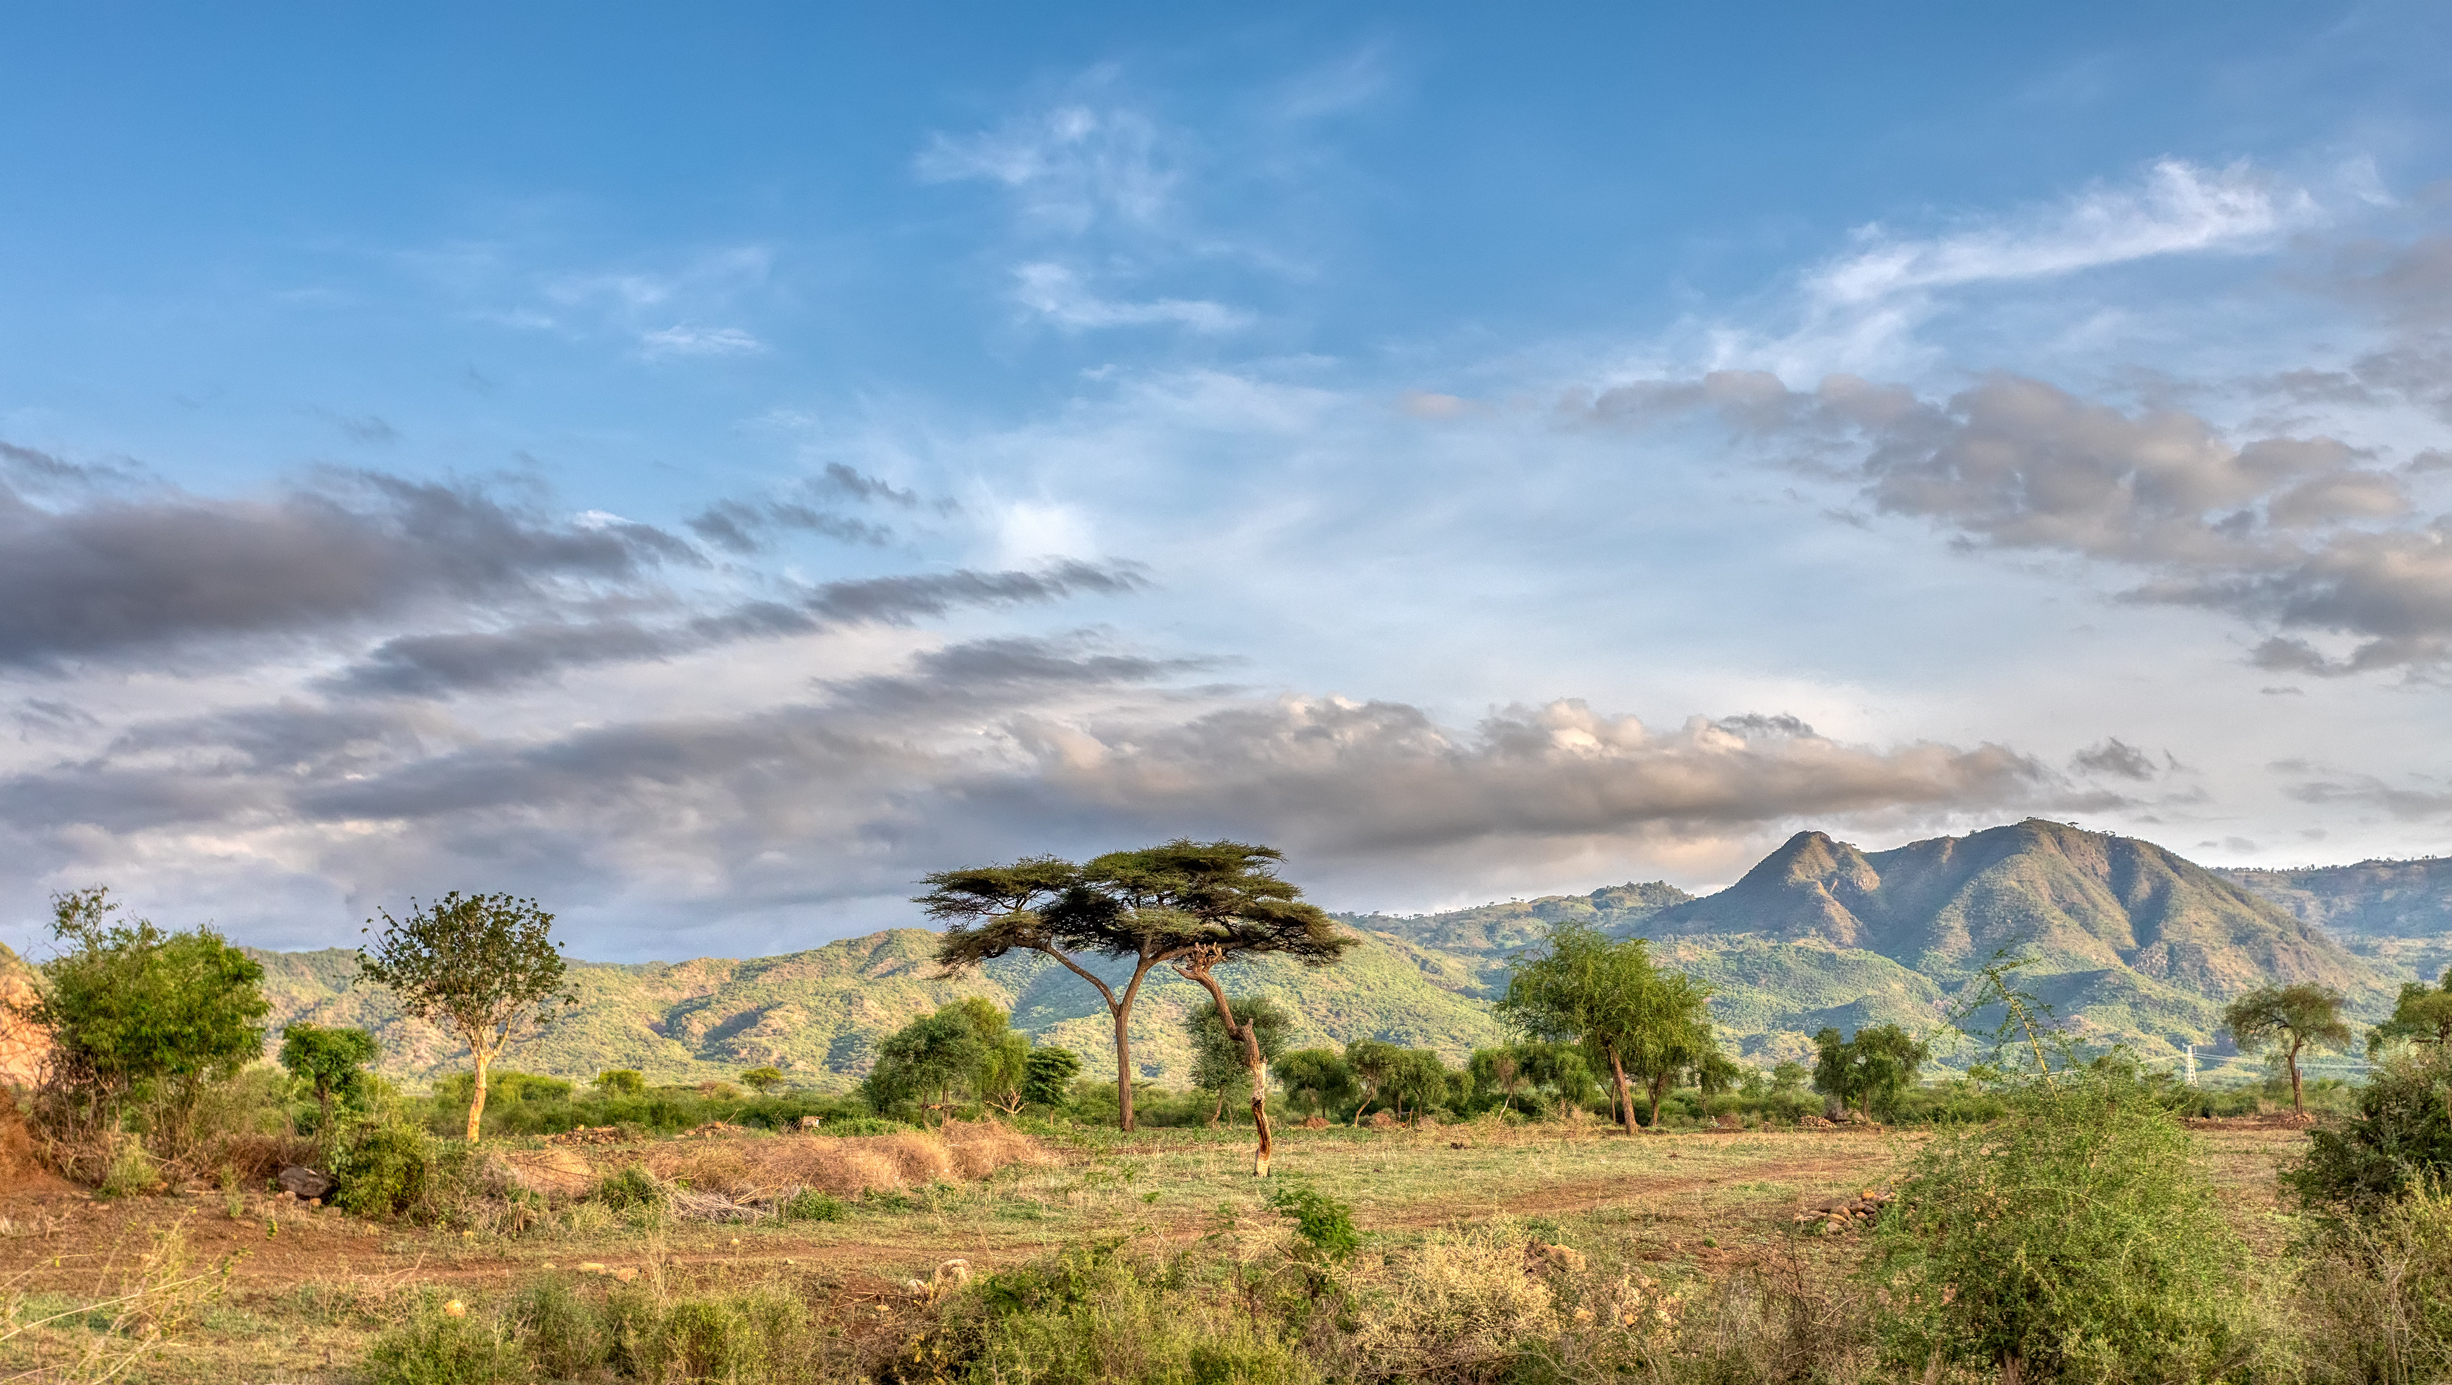
Challenges, Lessons and Impacts from Ethiopia’s National Ecosystem Assessment
Dr. Misikire Tessema
National Coordinator of Ethiopia’s NEA, Ethiopian Biodiversity Institute
Dr. Feleke Woldeyes Gamo
Project Focal Point, Deputy Director-General, Ethiopian Biodiversity Institute
Arba Minch – by ArtushFoto on AdobeStock

Slide 60

National Ecosystem Assessment_Ethiopia
Challenges, Lessons and Impacts
Misikire Tessema (PhD)
National Project Coordinator and
Feleke Woldeyes (PhD),
Project Focal Point, Deputy Director General
Ethiopian Biodiversity Institute
30 May 2022

Slide 61
Contents
Challenges
Lessons
Impacts

Slide 62
1. Challenges
1. Scoping phase (stage setting phase)
Understanding the approach
Identifying the authors (based, mainly, on the existing networks, to all author categories, editors and external peer reviewers)
Agreeing on the ecosystem types (such as whether to include “Mountain Ecosystem as separate ecosystem from the Forest and Woodland Ecosystem)
Formulating and validating Key policy questions to be addressed
Developing a road map for authors to pursue with their assessment

Slide 63
1. Challenges, …
2. Evaluation/implementation phase
Data collection
Compiling FODs and SODs
Engagement
Difficulty in:
compiling Draft Composite
Book and
finalizing the Book
COVID-19
referencing related inconsistencies
deviation from Harvard style
Lack of content harmony between & within Chapters
Incorrect cross-referencing of key findings to sections and sub-sections

Slide 64
2. Lessons
Lessons from the process
2. Lessons that we would have done otherwise if
we were to undertake similar tasks in the future

Slide 65
2. Lessons, …
    Lessons from the process
    Ecosystem assessment at national scale has enabled us to :
    clearly understand where the gaps are,
    acquire up-to-date information for informed policy and decision making and further research, and
    reassess our hitherto basis of classification of ecosystems:
    Agroecosystem
    Rangeland
NBSAP, MAPPING, NEA)- Ecosystem classifications

Slide 66
2. Lessons, …
    2. What would have we done otherwise?
    putting in place highest decision making body for strategic directions
    keeping functional Planning Team in place throughout
    the need for primary data where they were critically required
    more frequent catch-up meetings
    outsourcing:
    draft Composite Book compilation, and
    finalization of the Book
    - so as to take care of:
referencing mishaps,
cohesion, and
etc.
associated challenges

Slide 67
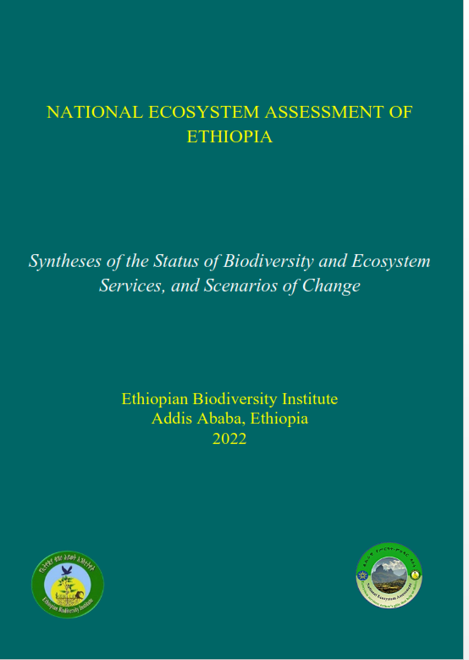
3. Impacts
Contents
Front matters
Introduction
Five Ecosystem Chapters
Conclusion and Recommendations
Glossary
Scenarios
713 Pages
In total, the Book contains
1. Front Matters, and
2. Nine chapters

Slide 68
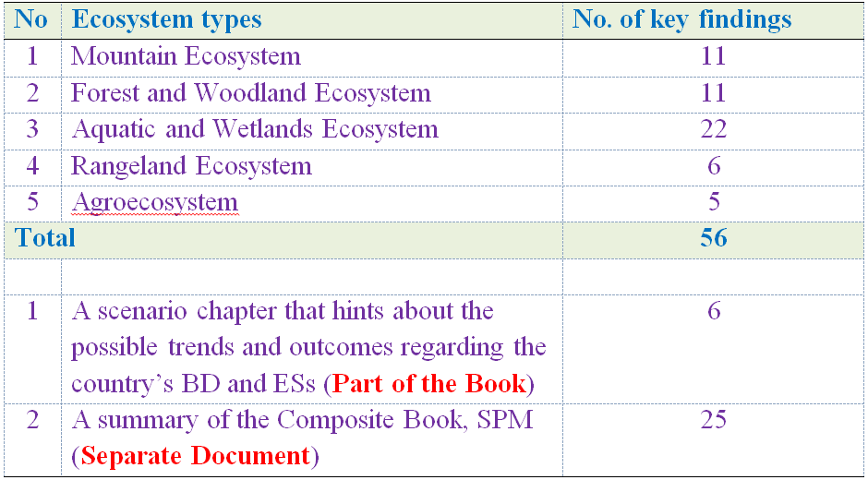
3. Impacts, …
The Book is the most important source of data and
information compiled in one, containing:

Slide 69
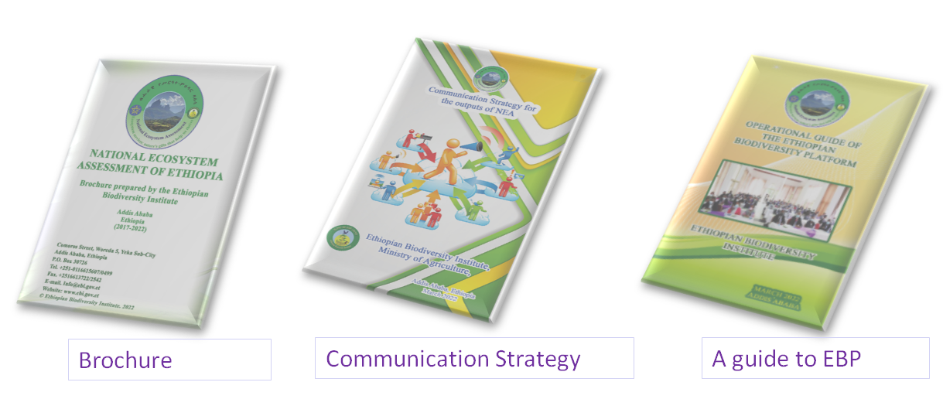
3. Impacts, …
Other Outputs

Slide 70
3. Impacts, …
3. 1. National level impacts
3.2. Contribution to effectively discharge international obligations
3. 1. National level impacts
The up-to-date data & information compiled in the Book will serve for:
raising of awareness of the general public and policy makers
further research by HL and research institutions,
informed decision Making (formulating new ones and/or capacitating the implementation of the existing policy issues

Slide 71
3. Impacts, …
3.2. Contribution to effectively discharge international obligations
Ethiopia is signatory to the CBD
CBD is legally binding
Articles 6 and pertinent CoP Decisions
(CoP 6 Decision VI/26 (2002), COP 10 Decision X/2) (2011)
Based on the forthcoming CoP 15 Decisions, planning Post 2020 Ethiopian BDF Goals, Targets/Actions will, therefore, be based on the findings outlined in the Composite Book.
For all these to happen, BES_NET is expected to play a significant role

Slide 72
Thank you for your attention!

Slide 73
Q&A

Slide 74
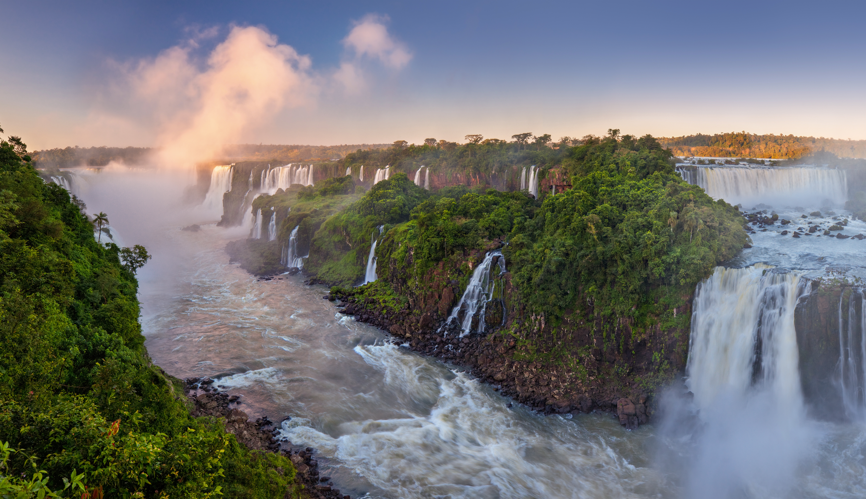

What’s next?
Webinar: Brazilian national platform and assessments experience
08th of June 2022 from 15:00 – 16:00 GMT
Iguazu Falls – by Valeriy on AdobeStock

Slide 75
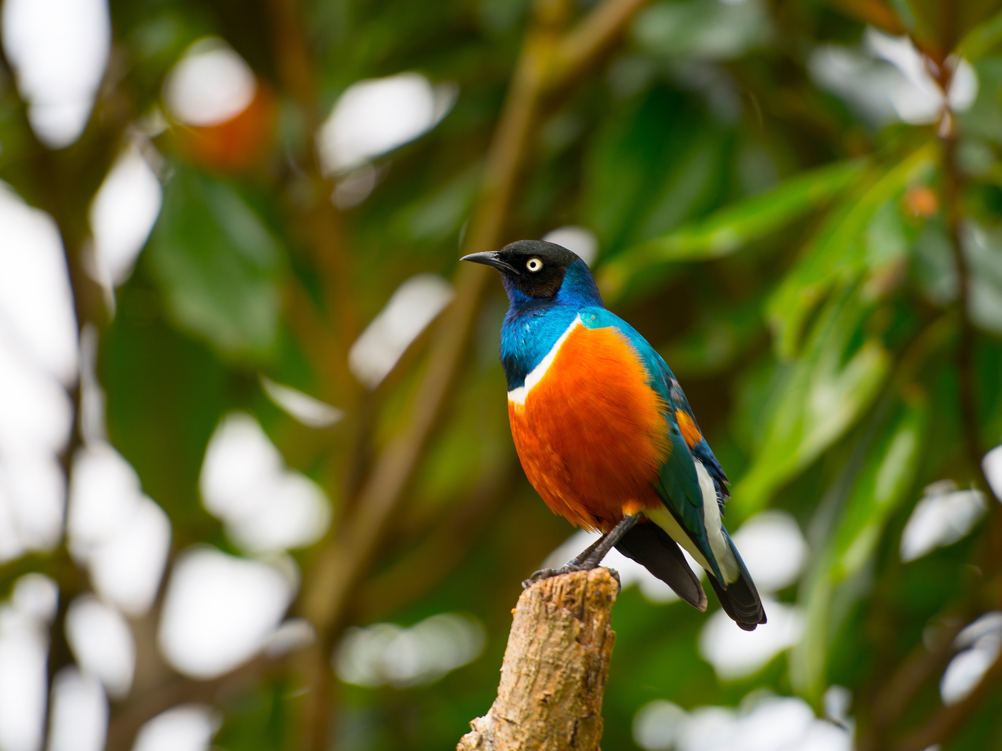

Thank you!
@mohanaantonmeryl
www.unep-wcmc.org
Facebook: @unepwcmc
Twitter: @unepwcmc
LinkedIn: UNEP-WCMC
YouTube: UNEP-WCMC Communications

